Slide 1
Barone2
Design Progress Review 3
Dylan Harootunian
Chin Ming Ryan Wong
Leonid Shuster
Jeremy Germenis
George Hernandez
Isaac Szu

Slide 2
Major Milestones of the Quarter
Create Functional Design Due 1/22/21: Complete
CAD with Major Design Features 1/29/21: Complete
Detailed CAD design 2/20/21: Complete
Fabricatable CAD Design Due 3/12/21: Delayed
RC controller receiver not finalized and cannot be implemented: Expected 3/21/21
Finalize all parts and retailers (CAD and electronics) Due 3/14/21: Late
Helium vendors have been looked at, but still in talks with school to see if a cheaper source can be found: Expected 3/25/21
Create Simulation Environment Due 2/5/21: Complete
Implement all major forces into simulation Due 3/7/21: Late
Drag Pushed back until after Remote control implementation: Expected 3/23/21
Implement open loop remote control simulation Due 1/29/21: Complete
System Definition in state space Due 3/7/21: Complete
Path Following and Terrain Tracking. Ideal Sensor Model Due 3/19/21: Late. Expected 3/21/21
Symbolic Plant Definition and PD full state feedback, but needs specific poles and integral control implemented
MORE ON NEXT SLIDE

Slide 3
Major Milestone of the Quarter Continued
Decide on microcontroller, microprocessor, and sensors Due 2/5/21 Complete
"Hello World" interface with sensor Due 2/26/21: Complete
Sensor Interrupts Due 3/7/21: Complete
All sensors working at the same time Due 3/19/21: Late
Delayed due to change in microcontroller: Expected 3/22/21
Implement electronic actuators into Systems Programing 3/19/21: Delayed
Due to the Sensors Code being delayed so are the actuator implementation : Expected 3/26
Schematic wiring complete 3/12/21: Complete
PCB Wiring Complete 3/19/21: Late
Late Change in microcontroller caused delays to wiring schematic: Expected 3/22/21
Verify PCB wiring by power management design Due Date: 3/23 - In Progress, expected by 3/23
Detailed power budget of all BoM parts 3/12/21: Complete
Simulate Passive Component Power Draw 3/23/21: Complete
Decide on power source 4/16/21: In Progress
Conclusion: After the last design review, we redefined our gantt chart milestones after realizing that our initial attempt was not sufficient. Since this update, the team has gone over the gantt chart as a group weekly to make sure we are on track and see where bottlenecks may show up. Team progress has been a lot smoother and progress accomplished much quicker. We have gone from weeks behind to only a few days and are expected to be caught up by the beginning of spring quarter.

Slide 4
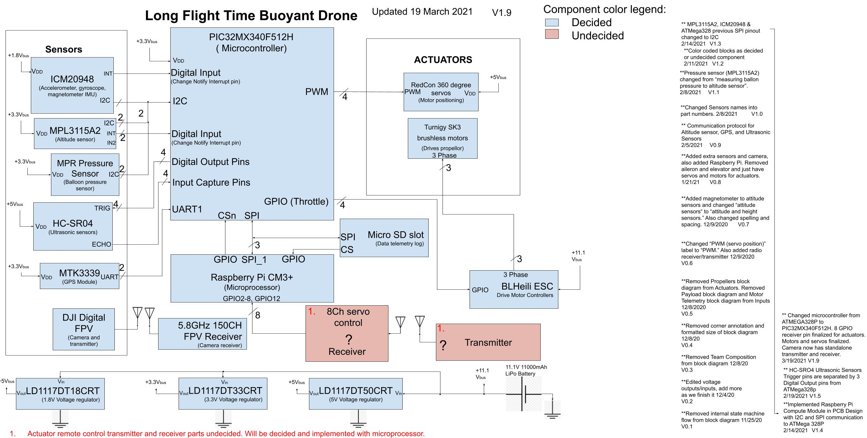
System Block Diagram
Goal: Show finalized and undecided components in system block diagram with names for finalized components and internal pin configurations.
Conclusion: Most parts have been finalized with the exception of the remote controller and transceiver. We wanted to confirm what data the client desired in live time before finalizing the decision.

Slide 5
Overview of Power Management Progress
Progress in Power Management was made and broken down into slides covering:
Milestone: Detailed power budget 3/7/21: Complete
Get Typical Power Requirements of Processing components - Complete
Get Typical Power Requirements of Sensors - Complete
Get Min/Max Power Requirements of Actuators - Complete
Milestone: Simulate Passive Component Power Draw 3/23/21: Complete
Simulate Passive Components used for communication and their Power Draw - Complete
Identify Power Rails Needed and Voltage Regulator Heat Loss- Complete
Milestone: Decide on power source 4/16/21: In Progress, Expected 4/16/21
Select Battery and Charger - In Progress, Expected 4/16/21
Estimate Min/Max Flight Time with battery - In Progress, Expected 4/16/21
Conclusion: Power Management milestone completion is on schedule. Power requirements were used to select a battery that would guarantee 30 minutes of flight time, while still being able to achieve 1 hr flight time depending on user control of the motors. Further efficiency estimates based off of average motor performance must be made to get a more exact flight time in between the minimum and maximum flight times.

Slide 6
Typical Power for Microcontroller & Microprocessor Included the I2C/SPI Passive Component Power
Complete
Requirement: Use datasheets to estimate typical power requirements of controlling components
Name | Description | Nominal Voltage(V) | Typical Current(mA) | Typical Power(mW) | Comments
PIC32 | Microcontroller | 3.3 | 55.5 | 183 | 55mA typical current required for executing code within SRAM or Flash Memory, .5mA typical current required for two I2C pull-up resistors in datasheet
Raspberry Pi Compute Modules | Microprocessor (All 6 power inputs) | 5,3.3,1.8 | 1,030 | 3,680 | Current variant on activity, recommended minimum power requirements from datasheet used in absence of typical power, although we will not exceed this due to low requirements needed for processor. Includes current needed for 4 SPI communication pull up resistors within 50mA max pin rail currents included in total current
CB3LV | 8MHz Crystal Oscillator | 3.3 | 20 | 66 | Typical crystal oscillator supply current needed, used for microcontroller clocks¹
ASEK | 32.768kHz crystal oscillator | 3.3 | 1.7 | 5.61 | ¹
Excerpt from Power Budget V4.0
Conclusion: Power per component is multiplied by the total flight time(in hours) to get the mWh requirements of all parts together to measure if the drone can achieve a desired flight time. Typical power required for these components equals 3940mW, including passive component power of I2C and SPI resistors, explained in a later slide

Slide 7
Typical Power Calculated for Sensors Included the Passive Component Power for UART and PWM
Complete
Requirement: Use datasheets to estimate typical power requirements of Sensors
Name | Description | Nominal Voltage(V) | Typical Current(mA) | Typical Power (mW) | Comments
MPL3115A2 | Pressure/Temperature Sensor | 3.3 | 0.265 | 0.875 | Typical current needed in high resolution mode
HC-SR04 | Ultrasonic Sensor(4) | 5 | 60 | 301 | Current needed for each sensor, added power for PWM usage by sensors(.844mW)
MTK 3339 | GPS Module | 3.3 | 20 | 67.2 | 25mA Acquisition of GPS Signal takes 30s max, 20mA for Tracking, adds 1.09mW for UART power usage
ANT-LTE-RPC-UFL | GPS Antenna | 3.3 | 8.6 | 28.4 | Follows specs recommended by GPS, typical current used
ICM-20948 | IMU Sensor | 1.8 | 3.11 | 5.6 | Typical current during data acquisition in 9-axis mode
BSS138 | Logic Converter(2) | 1.8 | 29.6 | 53.3 | Converts 1.8V and 3.3V I2C Lines, 53.3mW power dissipation total by converting
MPRLS0001 PG00001C | Pressure sensor IC | 3.3 | 3.03 | 10 | Power acquired from typical data acquisition current
Excerpt from Power Budget V4.0
Conclusion: Typical Power requirements for all sensor components equals 466mW, which includes communication power from UART and PWM as well, also shown on a future slide

Slide 8
Max/Min Power Analysis for Actuators Due to High Power Variance
Complete
Requirement: Research min/max power needed for actuators due to lack of datasheet info
Name | Description | Nominal Voltage(V) | Nominal High State Current Per Part(mA) | Nominal Low State Current Per Part(mA) | Max Power total(W) | Comments
20A 2-4S 4in1 ESC | ESC/ Motor Telemetry(4 count) | 11.1 | 136.1 | 48.1 | 6.04 | 20A max current from each of the 4 motor leads, 80A total, Estimating minimum ESC Efficiency of 95%[1], 5% of power is lost per motor
SK3 2822-1275kv | Motor(4 count) | 11.1 | 2,590 | 915 | 115 | Total current ranges from 2590mA per motor at full throttle to 915 mA per motor when hovering, based off of how many grams of thrust are needed(Equations on Next Slide)
Servo - DM 123 | Servo(4 count) | 5 | 400 | 1 | 8.0 | Depends on how much time drone is turning, Power ranges from 0-400mA per servo, 400mA when turning, 1mA when not turning Using current estimates from previous model datasheet which was very similar
Conclusion: Power required from the motor is based off how much thrust and turning time is needed from 0-100%, using controls for the thrust of the drone will depend on how much power will be needed to overcome drag force to move the drone around, with equations on the next slide. Power requirements will have to be tempered with these control estimations.
Total absolute actuator max power is 128W at max motor and servo performance while the absolute min power will be 42.8W at hovering motor and no servo performance
Excerpt from Power Budget V4.0
[1]MODELING AND TEST OF THE EFFICIENCY OF ELECTRONIC SPEED CONTROLLERS FOR BRUSHLESS DC MOTORS(2015, September. Retrieved March 10, 2021, from https://digitalcommons.calpoly.edu/cgi/viewcontent.cgi?article=2617&context=theses)(shows minimum efficiency for a 20A ESC operating at less than 15% current capacity)

Slide 9
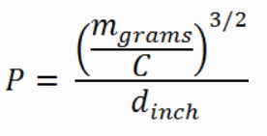
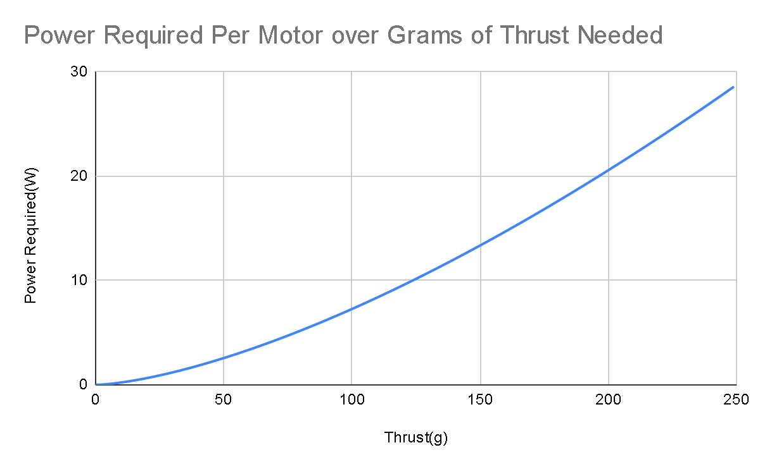
Motor Thrust Integration is Needed for Total and Average Flight Times
Complete
Requirement: Justify Min/Max Power Estimations for Motors
Main equation in use(also used for the graph)[2]:
m = thrust in grams d = propeller diameter in inches = 9 P = Nominal Power Required
C = 6.86 Air Density constant if air temperature at 20C and 1 atm pressure
Units of grams / (Watt * Inches)^2/3
4 brushless motors with min power efficiency of 85% and 500g total weight
(1)Power to hover(m = 125g per motor) = 10.2W at 11.1V is .915A
(2)Power at full throttle(m = 250g per motor) = 28.7W at 11.1V is 2.59A
(2)
(1)
Conclusion: Integrating by time over this equation with all the times of the amount of thrust needed can calculate the exact power per motor that is needed for a flight, but have been estimated for min/max power to decide on a necessary battery
[2]Equation from: How much power is needed to hover ? (2015, October 27). Retrieved March 1, 2021, from https://justdrones.com.au/how-much-power-is-needed-to-hover/#:~:text=If%20you%20want%20your%20model,and%20I%20is%20the%20current.(Verified by Multiple Thrust Test Results)

Slide 10
Passive Communication Component Power is Found to be Negligible Within Our System
Complete
Requirement: Calculate total passive power usage of communications
Included in Datasheets:
I2C: Connects IMU and pressure sensors to microcontroller, power typical required(1.65mW for SDA/SCL at 3.3V, .5mA) is handled by microcontroller power with internal pull up resistors.
SPI: Connects Microprocessor to SD card and Microcontroller, current included within minimum current requirements of 50mA max per set of pins for the microprocessor
Calculated:
PWM: Connects Ultrasonic Sensors to Microcontroller, signals every 60ms with a 11.6ms max high time will cause 10k ohm pull down resistors to dissipate .844mW max power to heat at 3.3V
UART: Connects GPS to Microcontroller, continuously communicating at a max rate of 20Mbps with an average of every other bit being 1 would require an average of 1.09mW of power in the 10k ohm pull up resistors for Rx and Tx lines at 3.3V
Conclusion: Power usage of passives together would equal 3.58mW average, which is less than .01% of total mW usage of the system, making it negligible but still included in budget for continuity.

Slide 11
Multiple Voltage Regulators Needed for Power Rails
Complete
Requirement: Identify Min/Max possible heat dissipation and power loss due to voltage regulators
Power Rails | Items Powered by Rail | Voltage(V) | Average Dropout Voltage(V) | Max Current of All Items on Rail(mA) | Max Regulator Heat Dissipation(W) | Comments
Rail 1 | 2 | 11.1 Nominal (Ranges from 12.6-9.6V) | 0 | 10,500 | 0 | No Regulator needed due to motor being able to take a variable voltage, but will lose performance over time
Rail 2 | 3 | 5 | 6.1 | 2,060 | 12.6 | Spread out over five 5V Regulators, no danger of going above 800mA guaranteed current of regulator
Rail 3 | 12 | 3.3 | 7.6 | 502 | 3.82 | 3.3V Regulator
Rail 4 | 3 | 1.8 | 9.3 | 268 | 2.50 | Two 1.8V Regulators
Excerpt from Power Budget V4.0
Voltage Regulators used have a guaranteed current of 800mA
Conclusion: 9.13W min to 18.9W max heat will be dissipated by the voltage regulators, depending on percentage of flight time servos are turning due to high current of the servos at 5V. Heat dissipation can be integrated similarly to the motor power usage for estimations in between

Slide 12
Battery Chosen for 30 Min Guaranteed and
1 Hour Capable Flight Time Requirements
In progress,
Due 4/16/21, Expected 4/16/21
Requirement: Select battery to achieve system technical requirements of .5 hr min flight
Name | Description | Voltage Input/Outputs | Current | Total Energy | Comments
LiPo Battery Charger | Charger | 100-240V AC (From outlet) | .1-10A adjustable | 100W max | With current battery, should take 59 minutes to fully charge from 83% depleted while auto-balancing cell voltages
LIPO 11.1V 3S 11Ah | Battery | Outputs: 12.6-9.6V, 11.1V Nominal | 9.13Ah of Capacity at 83%, Nominal 40C Rating, up to 440A capable | 122Wh capacity, 83% discharge: 102Wh total | 83% of 11Ah discharge for max current 5C charge rating, 48.5A max charge current 3.2 per cell cutoff voltage(9.6V total) 4.2 per cell max voltage(12.6V total)
83% Discharge to avoid 3.0V cell voltages causing damage to LIPO by limiting to 3.2V
Technical Requirements Met:
Battery Capacity of 102Wh is capable for 30 minute max power flight needing 76.1Wh with 24.9Wh still remaining
Is also Capable of up to an 100 minute flight at min power needing 101Wh
Max System Current is < 14A, 440A capable C rating above this(C x Capacity = Max Current)
Charger C rating is higher than necessary at 48.5A max charge with a 10A charger
Excerpt from Power Budget V4.0
Conclusion: Battery chosen has an ample amount of mWh capacity for use with our system regardless of the system performance, while also being much more than capable of delivering maximum current needed.

Slide 13
Estimated Achievable Min/Max Flight Times Meet Technical Requirements
In progress,
Due 4/16/21, Expected 4/16/21
Requirement: Find min/max flight times of drone given a power limit and drone motor/servo performance
Total Flight Time(Hours) | Percentage of Time Motors at Full Thrust(Opposite Percentage is Hovering) | Percentage of Time Servos are Turning | Total Energy Needed(Wh) Compared to 102Wh Battery(83% of battery cap) | Comments
.50 | 100% | 100% | 76.1 | Guaranteed 30 min flight at highest performance
.66 | 100% | 100% | 100 | Minimum flight time of 40 minutes at highest performance
1.0 | 46%(Arbitrary) | 50%(Arbitrary) | 101 | 1 hr flight possible given 50% servo turning and full throttle control
1.68 | 0% | 0% | 102 | Max flight time of 100 minutes while hovering in place
Excerpt from tests of Power Budget V4.0
Conclusion: Drone Flight time will always exceed 30 minutes, as per our system technical requirements, while also achieving our 1 hr flight time stretch goal if the drone is hovering for 54% of the time while motors can be used at any throttle for the other 46% of the time in flight, as an arbitrary example from a customized calculator on the power budget.
The exact time of the drone’s flight within the minimum and maximum flight time can be achieved by integrated along the times of the percentage of throttle used, as shown in a previous slide

Slide 14
Overview of PCB milestones
Progress in autonomous controls were made and broken down into slides covering:
Schematic wiring Complete
Terrain tracking Complete
High altitude tracking Complete
Fall detection IMU Complete
Popped balloon error handling Complete
GPS path following Complete
SPI communication Complete
Motor and servo pinouts Complete
PCB wiring Due Date: 3/19 - In Progress, expected by 3/22
20% complete
Verify PCB wiring by power management design Due Date: 3/19 - In Progress, expected by 3/23
Conclusion: On track to complete PCB wiring by March 22 and verify PCB wiring by the 23rd, BOM will be updated with any changes to the PCB design.

Slide 15
PCB Board Design Rule Check matches with OSH Park specifications
In progress,
Due 3/22/21, Expected 3/22/21
Goal: Show configuration of Eagle CAD DRC is matching with OSH Park specifications
4 Layer PCB design follows OSH Park specifications
Top soldering and data line copper layer is 1.4mil
Second ground plane copper layer is 0.7mil
Third 3.3V rail plane copper layer is 0.7mil
Bottom data line copper layer is 1.4mil
Minimum via hole drill size follows OSH Park specifications
Minimum drill size defined as 10mil
Eagle CAD via holes for I2C, SPI, and any data lines use 10mil via holes
Voltage rails will use multiple 10mil via holes to lower power loss to components
Conclusion: PCB board DRC follows OSH Park specifications. Finished PCB wiring file will be accepted by OSH Park for manufacturing.

Slide 16
Microcontroller changed to Microchip PIC32 for better C programming compatibility in MPLAB X IDE
Complete
Requirement: Microcontroller shall support all sensor and microprocessor communication protocols and also provide PWM signal output to actuators.
Multiple members of the team is familiar with programming the PIC32MX340F512H microcontroller
PIC32 microcontroller supports:
UART protocol for GPS sensor[1]
I2C protocol for altitude sensor, balloon pressure sensor, and IMU sensor[2]
SPI protocol to send sensor readings to microprocessor[3]
ICSP debugging with Microchip PICkit3[4]
Input Capture pins for interrupt driven array of ultrasonic sensors[5]
Output Compare/PWM pins for driving servo and motors[6]
Change Notification input pins for interrupt driven IMU and altitude sensing[7]
Includes extensive family reference manual that explains all hardware level registers of PIC32 microcontroller
PIC32 microcontroller debugged via ICSP pinouts using the PICKit 3 debugger
MPLAB X IDE will be used due to its optimization for controlling PIC32 microcontroller using C programming language
Conclusion: PIC32 microcontroller is chosen over previous ATMega2560 due to its support for entire suite of sensors and due to team’s familiarity with the microcontroller.
[1] UART PIC32 Family Reference Manual: https://ww1.microchip.com/downloads/en/DeviceDoc/60001107H.pdf
[2] I2C PIC32 Family Reference Manual: https://ww1.microchip.com/downloads/en/DeviceDoc/60001116G.pdf
[3] SPI PIC32 Family Reference Manual: https://ww1.microchip.com/downloads/en/DeviceDoc/61106G.pdf
[4] PICkit 3 User’s guide https://ww1.microchip.com/downloads/en/DeviceDoc/51795B.pdf
[5] Input Capture PIC32 Family Reference Manual: https://ww1.microchip.com/downloads/en/DeviceDoc/60001122G.pdf
[6] Output Compare PIC32 Family Reference Manual: https://ww1.microchip.com/downloads/en/DeviceDoc/61111E.pdf
[7] PIC32MX340F512H Data Sheet:https://ww1.microchip.com/downloads/en/DeviceDoc/61143H.pdf

Slide 17
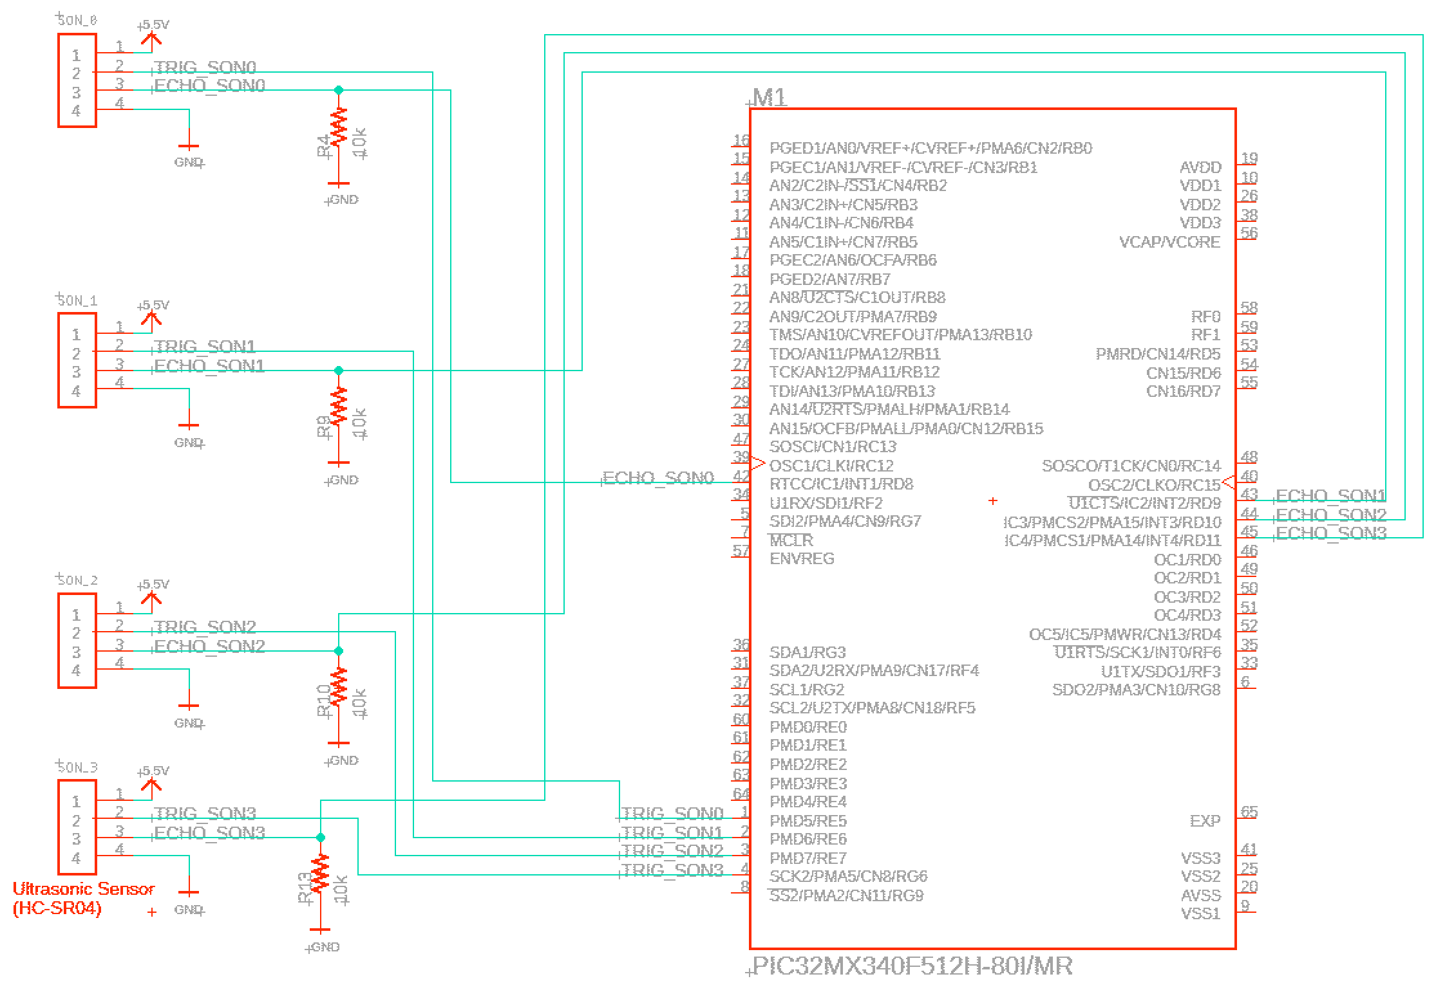
Hardware Implementation for Autonomous Terrain Tracking
4.2.1
Complete
V1.9
Goal: Understanding how terrain tracking is implemented in hardware.
Requirement: The sensors shall be able to monitor area
in front of the drone in order to maintain
constant height of 1 meter.
Each HC-SR04 ultrasonic sensor is powered by 5V rail.
Trigger pin connects to digital output pins of microcontroller. Logic high of TRIG commands ultrasonic sensor to begin sensing terrain
Echo pin connects to Input Capture pin. Input Capture records length of time when ECHO pin is high.
Input capture pins are interrupt driven, does not require main program to halt while waiting for falling edge to be received from the echo pin
Total of 4 ultrasonic sensors, each with individual trigger and echo pins connected to the microcontroller.
Conclusion: Hardware implementation of ultrasonic sensors is complete using digital output pins for terrain read command and input capture pins for distance reading
PIC32MX340F512H
(microcontroller)
Pull-down resistors for idle low echo pins
Input capture is interrupt driven to record high time of each echo pins from HC-SRO4 ultrasonic sensors.
Input Capture pin 1
Input Capture pin 2
Input Capture pin 3
Input Capture pin 4
Logic high >10us for request of terrain reading
Digital Output pin 1
Digital Output pin 2
Digital Output pin 3
Digital Output pin 4
Pinout configuration of HC-SR04 ultrasonic sensor to microcontroller

Slide 18
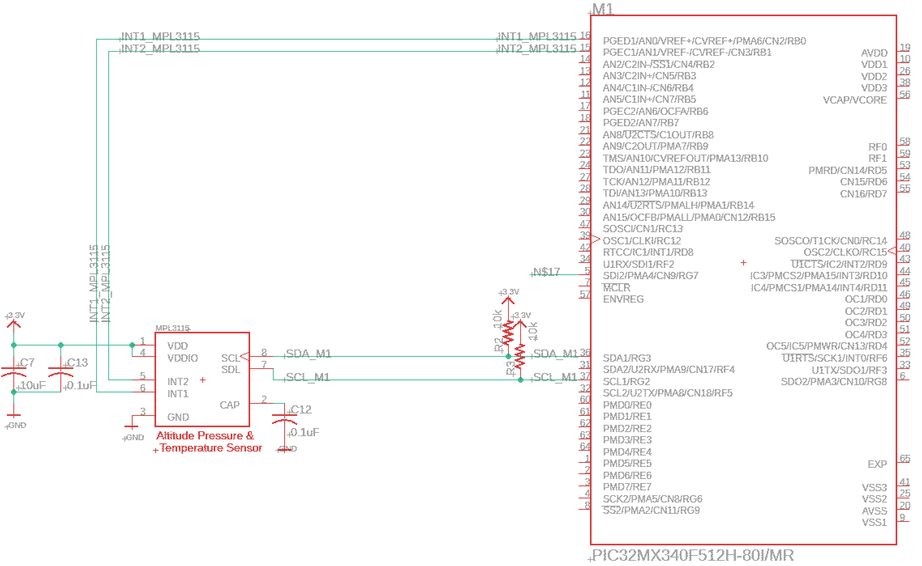
Hardware Implementation of Autonomous High Altitude Tracking with Barometric Sensor
Complete
4.2.2
V1.9
Goal: Understand how the MPL3115 barometric/altitude sensor sends pressure and temperature data to microcontroller using I2C.
Requirement: The sensor shall be able to monitor altitudes above 4m for drone altitude awareness.
Altitude sensor SDA and SCL lines connected to microcontrollers SDA1 and SCL1 lines for sending pressure and altitude data via I2C.
SDA and SCL lines require external 10k pull-up resistor to 3.3V for idle high mode.
Altitude sensor’s interrupt output pins are connected to input interrupt pins of the microcontroller.
Only when new altitude data is available, ISR of microcontroller will trigger. Main program does not need to routinely check for new data.
Change notification pins of microcontroller is used to allow interrupt driven I2C altitude data collection
Conclusion: Autonomous high altitude tracking hardware implementation uses I2C bus to send pressure and temperature data to microcontroller.
PIC32MX340F512H
(microcontroller)
Change Notification Pin 1
Change Notification Pin 2
Change notification pins trigger interrupts when new pressure/temperature data is available from barometric sensor
I2C bus requires external pull-up resistors for idle high
I2C bus receives pressure and temperature data when interrupt occurs from change notification pins
SDA1
SCL1
Pinout configuration of MPL3115 barometric sensor to microcontroller

Slide 19
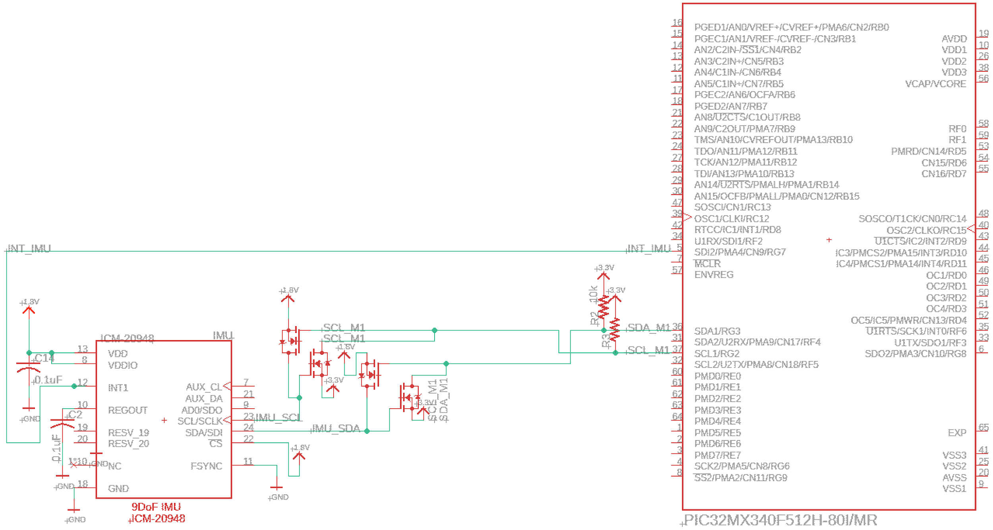
Hardware implementation of fall detection IMU
Complete
4.3.1
V1.9
Goal: Understand how the IMU 9D0F sensor sends acceleration, magnetometer, and gyroscope data via I2C.
Requirement: The IMU should be able to detect crashes and abnormal situations and feed the data back into the system.
ICM-20948 IMU sensor’s interrupt output pin are connected to input interrupt pins of the microcontroller.
Only when new sensor data is available, ISR of microcontroller will trigger. Forcing microcontroller to read new data via I2C bus.
IMU sensor communicates with microcontroller via I2C protocol
BSS138 Logic level field effect transistors are added to convert from 3.3V (I2C bus outputting from PIC32 microcontroller) to 1.8V input into 9DoF IMU sensor and 1.8V output from IMU to 3.3V into PIC32 microcontroller.
Conclusion: Fall detection is implemented by interrupt driven IMU sensor. Logic level converters are needed resolve issues with connecting 1.8V IMU sensor to 3.3V microcontroller.
PIC32MX340F512H
(microcontroller)
Change notification pins trigger interrupts when new accelerometer/magnetometer/gyroscope data is available from IMU sensor
BSS138 logic level FET converts 3.3V to 1.8V for IMU I2C input, and converts 1.8V I2C bus from IMU to 3.3V to microcontroller I2C bus
Change Notification Pin 1
SDA1
SCL1
I2C bus receives accelerometer/magnetometer/gyroscope data depending on register address requested.
Unused SPI bus CS pin is connected to 1.8V
Pinout configuration of ICM-20948 IMU sensor to microcontroller

Slide 20
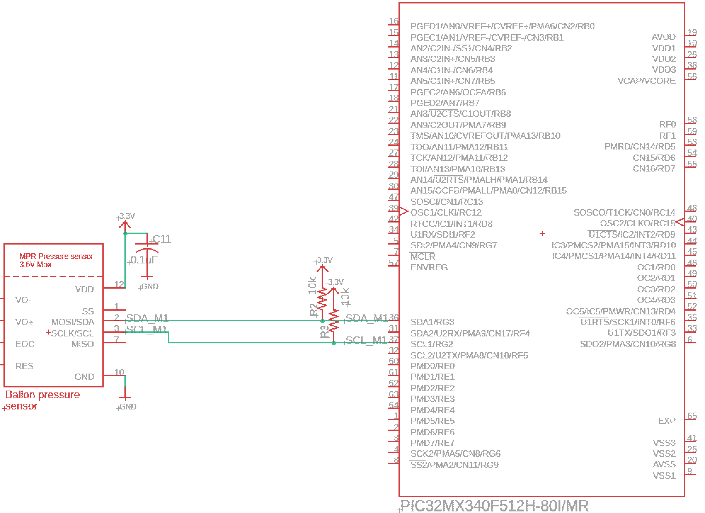
Hardware Implementation for Popped Balloon Error Handling
Complete
4.3.3
V1.9
PIC32MX340F512H
(microcontroller)
Goal: Show how the balloon pressure sensor sends pressure data via I2C to microcontroller
Requirements: The drone should be able to detect a popped balloon with a pressure sensor and by calculating the force needed to stay afloat. Will make emergency landing if popped.
Pressure sensor senses pressure difference applied on the IC chip itself. A tube is connected from the pressure sensor to the opening of the balloon.
When pressure drops in the ballon, the data sent via I2C will decrease. Microcontroller will detect a pressure difference and return a pressure drop error.
Conclusion: MPR Pressure sensor sends pressure data periodically via I2C protocol to microcontroller. Microcontroller periodically checks for pressure difference in main program.
Pull-up resistors needed for I2C bus to idle high
Microcontroller checks balloon pressure periodically via I2C bus
SDA1
SCL1
Pinout configuration of MPR balloon Pressure Sensor to microcontroller

Slide 21
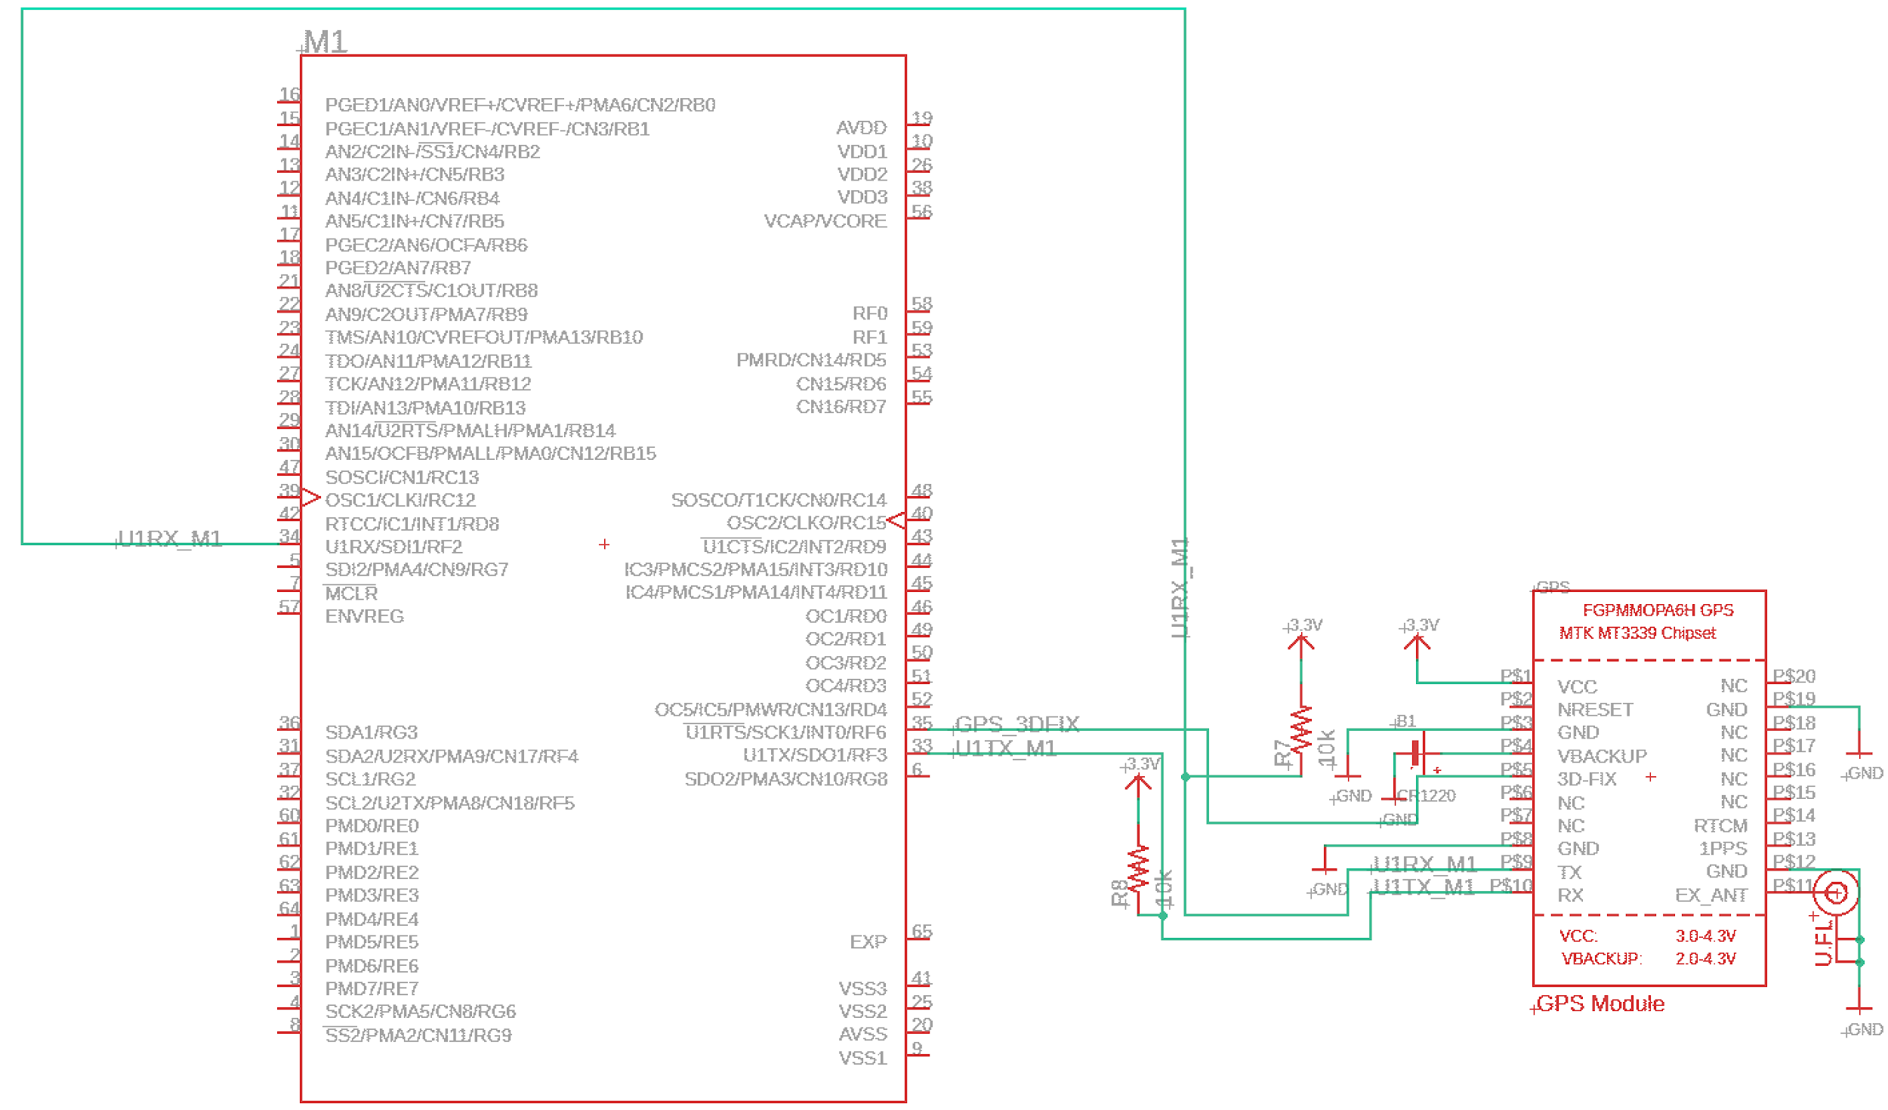
Hardware Implementation of Autonomous GPS path following
Complete
4.1.1
V1.9
Goal: Understand how the microcontroller knows when GPS module has satellite lock and how coordinates are received by microcontroller.
Requirements: The sensor shall be accurate within 5m of its location with sample of at least 3Hz.
MT3339 GPS Module sends longitudinal and latitudinal coordinates via UART protocol to the microcontroller.
GPS module’s 3DFIX pin outputs logic low when there is a GPS satellite lock
Conclusion: GPS coordinates transmitted via UART pins to the MC.
PIC32MX340F512H
(microcontroller)
Receiver pin for longitude and latitude coordinates
U1RX
Digital Input
U1TX
3DFIX pin logic low when at least 1 satellite lock
Pinout configuration of MT3339 GPS module to microcontroller

Slide 22
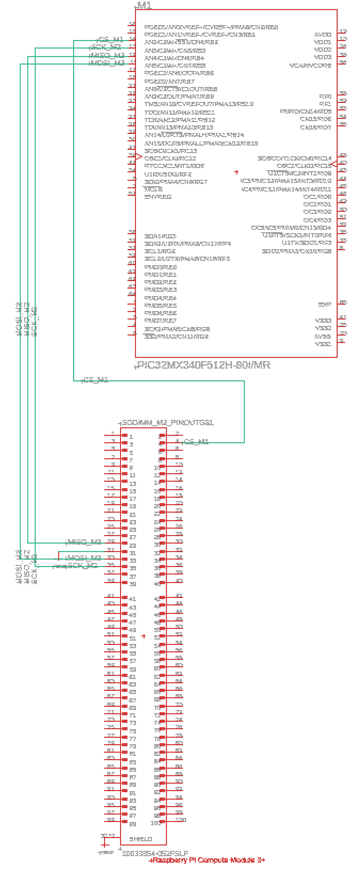
SPI Communication between microcontroller and microprocessor
V1.9
Complete
4.8.0
Chip Select input pin
CSn
SCK
MISO
MOSI
SPI bus
SCK
Goal: Show how the PIC32 microcontroller sends sensor data to Raspberry Pi CM3+ microprocessor via SPI communication.
Requirements: The drone should be able to determine its pitch, yaw, roll, and NED states, as well as their derivatives to use in the autonomous functionality and error detection systems.
Microprocessor is the SPI master, requests sensor data from microcontroller via MOSI pin and sends actuator controls.
Microcontroller is the SPI slave, sends sensor data via MISO pin.
Microprocessor compute module plugs into a DDR2-SODIMM slot
DDR2-SODIMM slot pinout connects to microcontroller SPI bus
Conclusion: Microprocessor takes in sensor data from microcontroller via SPI to determine servo and motor control.
MISO
PIC32MX340F512H
(microcontroller)
MOSI
GPIO
out
Chip Select output pin
MISO MOSI
SCK
SPI bus
Raspberry Pi CM3+
(microprocessor)
DDR2-SODIMM slot

Slide 23
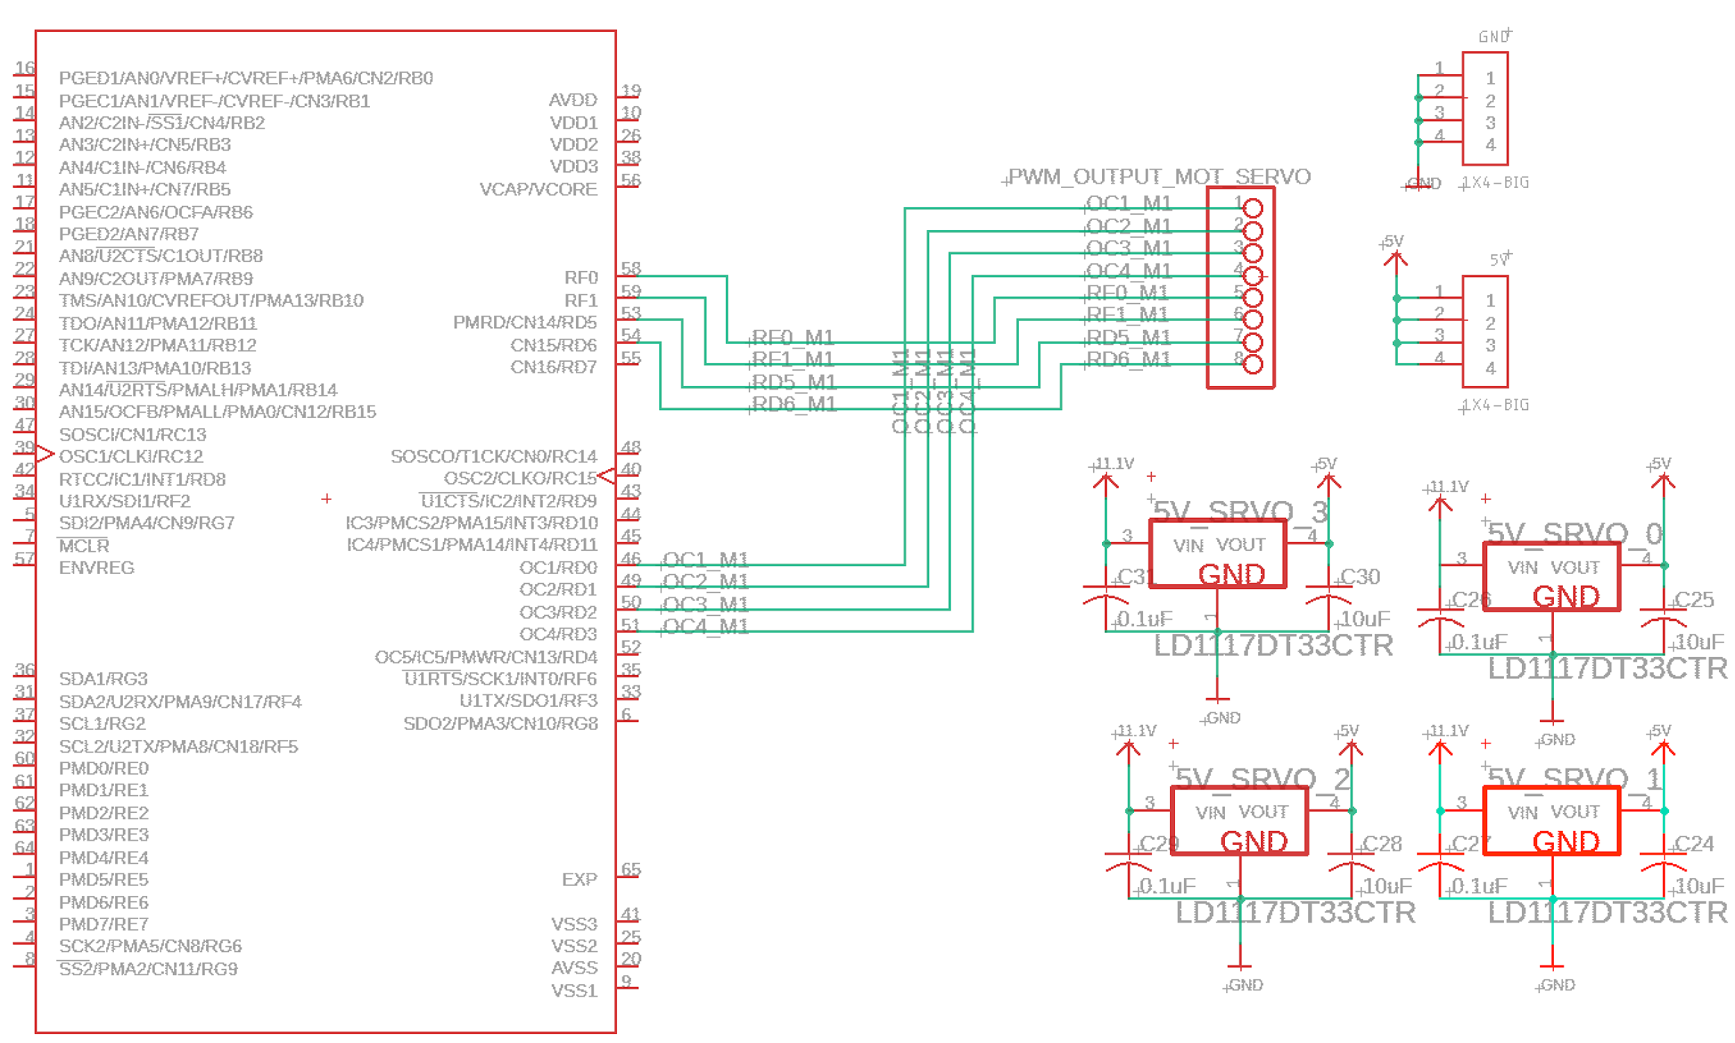
Implementation of Hardware Pinouts for Motor and Servo control
V1.9
Complete
8 through hole solder points connects to 4 PWM pins to microcontroller and 4 digital output pins
4 through hole solder points for +5V rail
4 through hole solder points for GND
Goal: Show how servos and motors are controlled by the PIC32 microcontroller via output capture pins and digital output pins.
Four Output Compare pins from microcontroller outputs PWM signal to motor ESC
Four digital output pins connects to 1x4 through hole headers
Four 5V voltage regulators, each provides 5V output to 1x4 through hole headers for the servos
Four 1x4 through hole headers provide path to ground for the servos
Conclusion: Servos are directly controlled by PIC32 controller via digital output pins from the microcontroller. Four additional 5V rail pinouts provides power to the servos via the through hole headers. Four Output Compare pins output PWM signal to ESC motor control.
PIC32MX340F512H
(microcontroller)
Digital Out pin 1
Digital Out pin 2
Digital Out pin 3
Digital Out pin 4
OC/PWM pin 1
OC/PWM pin 2
OC/PWM pin 3
OC/PWM pin 4
Four 5V voltage regulators to power each servo

Slide 24
Verify PCB wiring
In progress,
Due 3/23/21, Expected 3/23/21
Goal: Ensure supply voltages to all components are sufficient by verifying with power management system.
Requirement: PCB design shall provide nominal voltage and current required by microcontroller, microprocessor, sensors, and servos.
PCB wiring verification is in progress and on track to completion
PCB verification expected to be complete by 3/23, the day after PCB wiring is complete
Conclusion: PCB wiring needs to be finished for wiring to be verified by power management

Slide 25
Overview of Sensors Programming Progress
Progress in sensors programming was made in the following ways:
Milestone: Decide on microcontroller, microprocessor, and sensors Completed 2/5/21
Milestone: Basic software interface with microcontroller sensors Completed 2/26/21
Milestone: Read from sensors using interrupts Completed 3/19/21
Switched from ATMega to PIC32 microcontroller
Using ultrasonic sensors to determine distance Complete
Using IMU sensor to determine acceleration, angular acceleration, and magnetic field Complete
Using altimeter to determine altitude and temperature Complete
Using GPS to determine longitude and latitude Complete
Milestone: Reading from all sensors at the same time Late - Due Date 3/19/21, Expected 3/22/21
Milestone: Implement electronic actuators in software (ESC, motor, servos) Delayed - Due Date 3/19/21, Expected 3/26/21
Conclusion: All sensors were successfully read from individually, but reading from all of them at the same time is behind schedule due to a late change in microcontroller

Slide 26
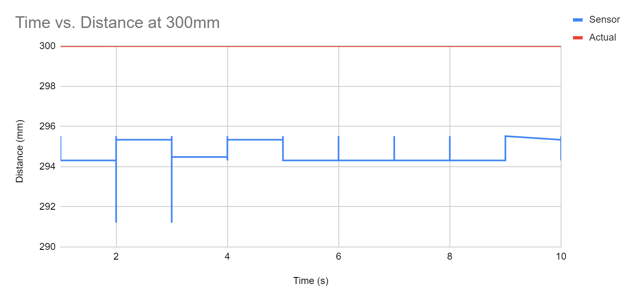
Ultrasonic Sensors were Configured with Interrupts and Input Capture
Complete
Requirement: Use ultrasonic sensors to determine distance from drone
Interface procedure:
Every 60ms, raise trigger pin high for 10us using timer and interrupts
Time how long echo pin stays high with input capture tracking state of echo pin
Determine distance from ultrasonic knowing that speed of sound is 343 m/s
Verification:
Tested at a distance of a constant 300mm (measured with ruler) from obstacle:
Average distance of 294mm measured
Conclusion: Ultrasonic sensors were able to determine distance within 6mm

Slide 27
IMU Sensor was Configured with I2C and Interrupts
Complete
Requirement: Use IMU sensor to determine acceleration, angular acceleration, and Earth’s magnetic field along x, y, z axes
Interface procedure:
Set up I2C protocol with PIC32 as master and IMU as slave
Read from IMU when interrupt pin on IMU goes high signifying it has new data
Convert raw data to acceleration, angular acceleration, and magnetic field
Verification and Conclusion:
Shown on next slide

Slide 28
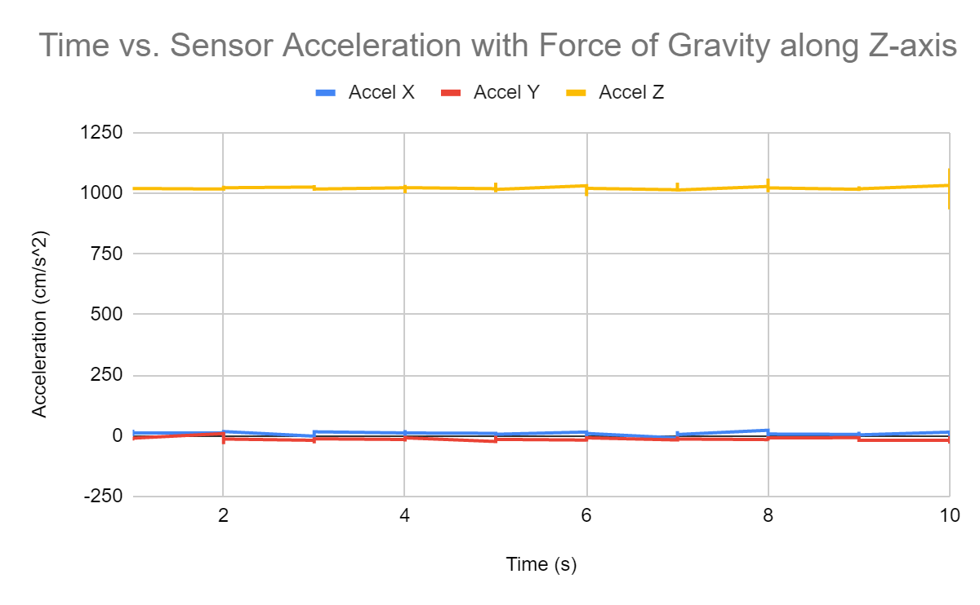
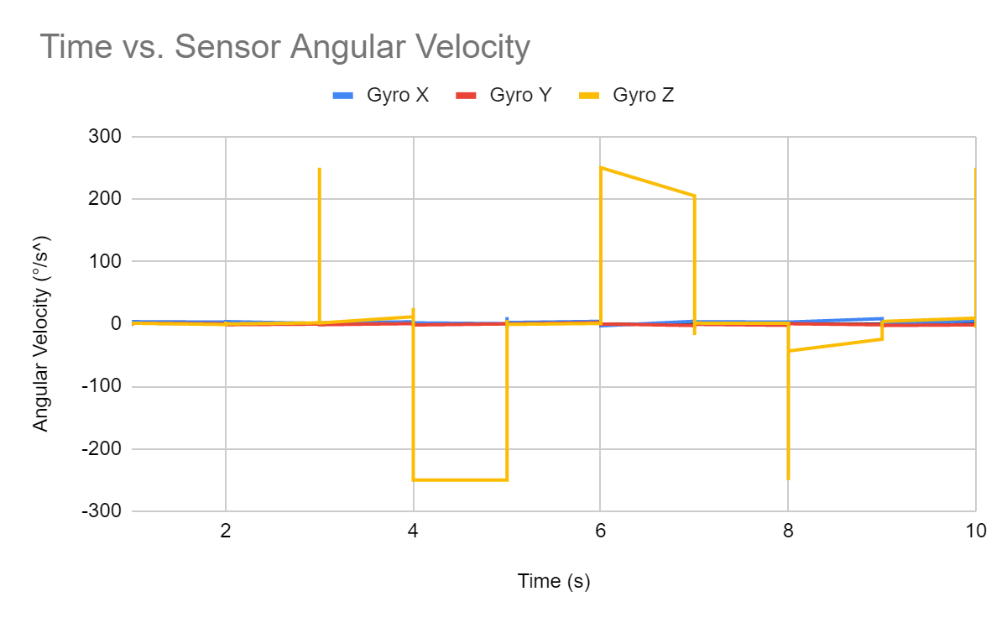
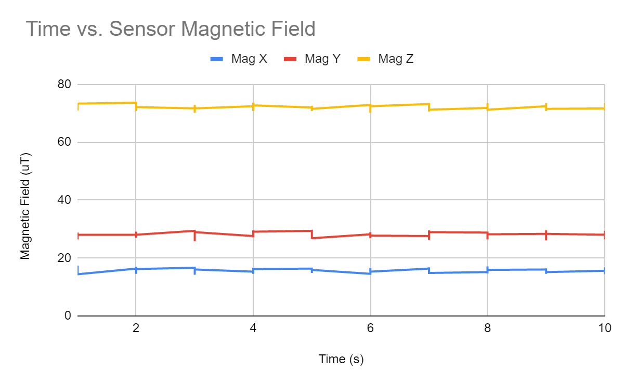
IMU Sensor was Configured with I2C and Interrupts: Verification and Conclusion
Complete
Measured with IMU flat on the table
Expected value of F_{g} = 980 cm/s² only along Z-axis, 0 along other axes
Actual Average Values:
Accel_{x}= 9.341180124 cm/s²
Accel_{Y} = -14.13291925 cm/s²
Accel_{Z} = 1020.67764 cm/s²
Measured while rotating IMU back and forth 270° along Z-axis
Expected value of 0°/s on every axis
Actual Average Values:
Gyro_{x}= 2.132857143 °/s
Gyro_{Y} = -0.8745962733 °/s
Gyro_{Z} = 12.26204969 °/s
Measured with IMU flat on the table
Standard magnitude of Earth’s magnetic field between 25 to 65 uT
Actual Average Values:
Mag_{x}= 15.72670807 uT
Mag_{Y} = 27.92142857 uT
Mag_{Z} = 71.92639752 uT
Magnitude = 33.14908623 uT
Conclusion: IMU detects acceleration, angular acceleration, and magnetic field but there is an obvious offset that can be eliminated by biasing the IMU before using it

Slide 29
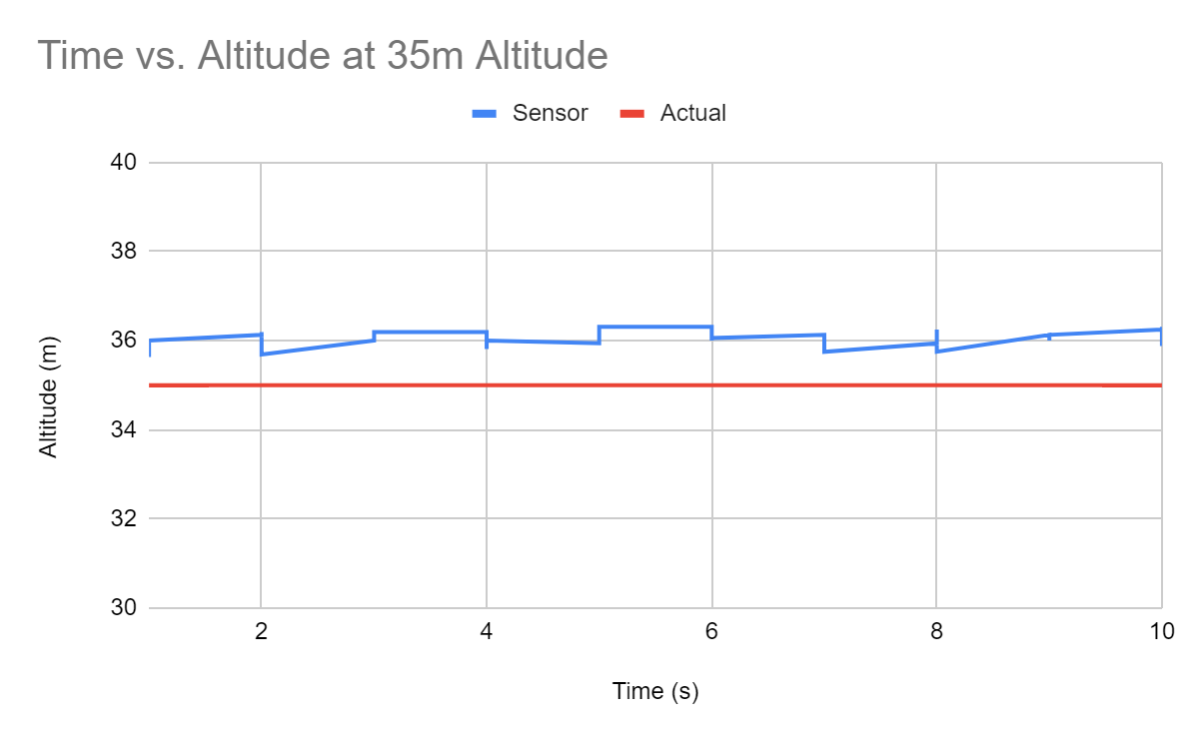
Altimeter was Configured with I2C and Interrupts
Complete
Requirement: Use altimeter to determine altitude
Interface procedure:
Set up I2C protocol with PIC32 as master and altimeter as slave
Read from altimeter when interrupt pin on altimeter goes high signifying it has new data
Convert raw data to pressure and calculate altitude based on pressure
Verification:
Tested at an altitude of a constant 35m (taken from Google Earth):
Average altitude of 36.0375m measured
Conclusion: Altimeter was able to determine altitude within 1m

Slide 30
GPS Sensor was Configured with UART and Interrupts
Complete
Goal: Configure GPS sensor to determine latitude and longitude
Procedure:
Set up UART protocol between PIC32 and GPS
GPS gets new position at 10Hz update rate, and sends it over UART which triggers an interrupt for PIC32
Convert raw data to latitude and longitude
Verification and Conclusion:
Shown on next slide

Slide 31
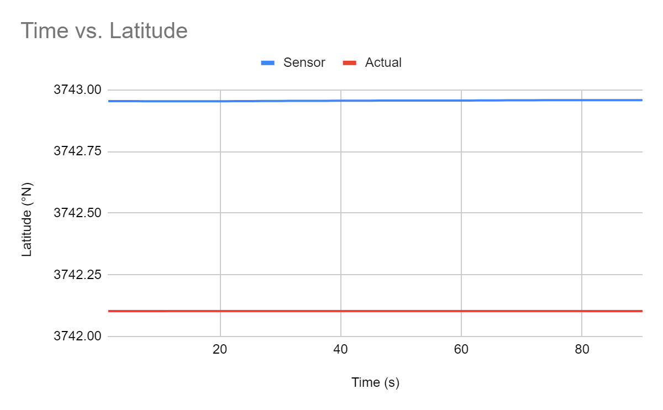
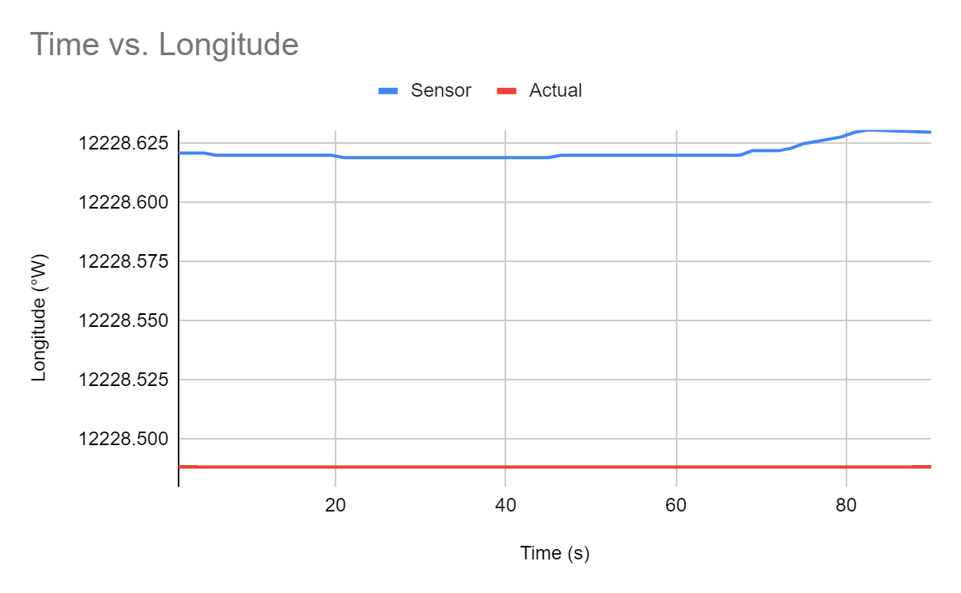
GPS Sensor was Configured with UART and Interrupts: Verification and Conclusion
Complete
Tested at a GPS location of 37°42'10.299''N and 122°28'48.828''W:
Average GPS location was 37°42'9.55763''N and 122°28'6.2099''W, approximately 2500ft away
Conclusion: GPS was able to determine latitude and longitude with offset of 3000ft, possibly caused by not letting GPS sensor warm up

Slide 32
Reading From All Sensors at the Same Time is Behind Schedule
Late: Due 3/19/21
Expected: 3/22/21
Requirement: Read from all sensors at the same time with interrupts
What needs to be done:
Write one file that includes all the other sensor files
Set and run every sensor at the same time without any conflicting hardware parts, data or interrupts
Verification to be done:
Run every sensor at the same time and log each of their datas collectively
Graph data and compare with data gathered from running sensors individually to see if anything changed

Slide 33
Implementing Electronic Actuators in Software is Behind Schedule
Late: Due 3/19/21
Expected: 3/26/21
Requirement: Implement servo and motor PWM protocol in software
What needs to be done:
Produce PWM signal for both servo and motor with changeable duty cycle to increase rotation speed
Verification to be done:
Ensure rotation speed can easily be altered based on user input

Slide 34
Overview of Mechanical Progress
Progress in Mechanical Design were made and broken down into slides covering:
Milestone: CAD with Major Design Features 1/29/21: Complete
Milestone: Detailed CAD design 2/20/21:Complete
Envelope Redesigned for Drag:Complete
Gondola Designed to Fit all electronic components Complete
Milestone: Fabricatable CAD design due 3/12 : Delayed
RC controller is not finalized so the receiver has not been added to CAD. Expected 3/21
Finding RPM needed to provide propeller forces Complete
Choosing a Motor Based off of RPM analysis Complete
Choosing Servo Based off of Torque from motor shaft Complete
Choosing Envelope Material to withstand applied tearing forces Complete
Choosing 3D printing Material From Pugh Chart Complete
Create Ultrasonic Bracket for front of envelope Complete
Heat Analysis of Voltage Regulators Complete
Milestone: Finalize all parts and retailers (CAD and electronics) Due 3/14/21: Late
Helium vendors have been looked at, but still in talks with school to see if a cheaper source can be found: Expected 3/25/21
Conclusion: We are on time for the Project timeline for Mechanical design development, and have finalized most essential components

Slide 35
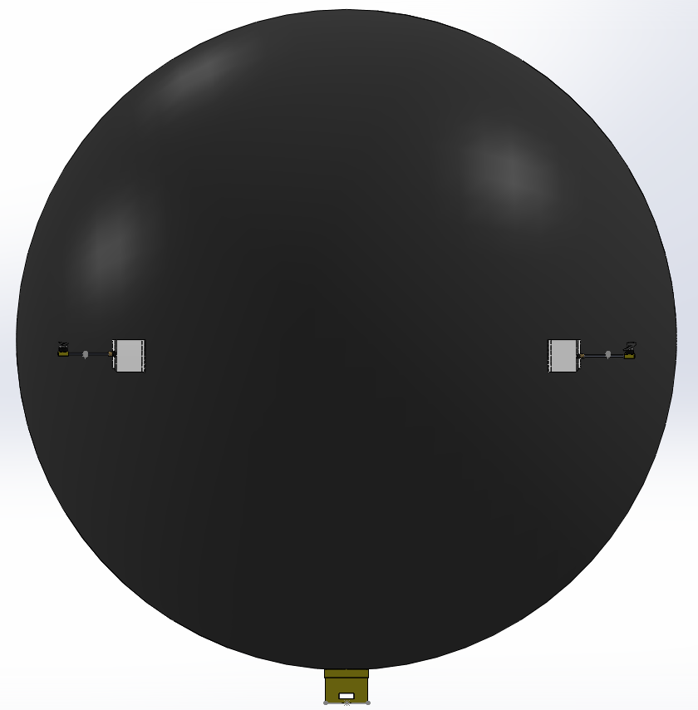
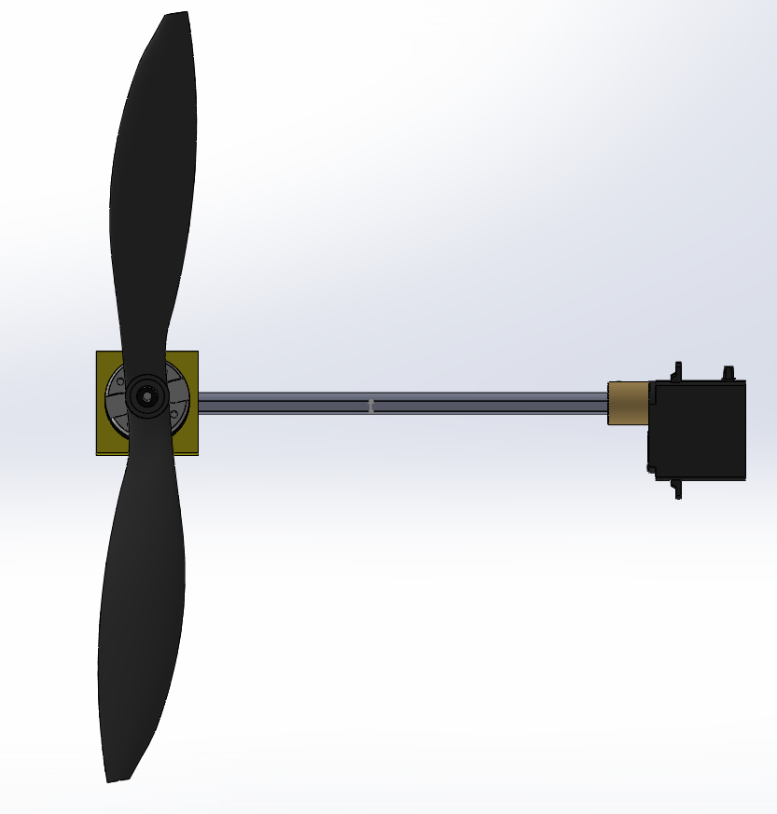
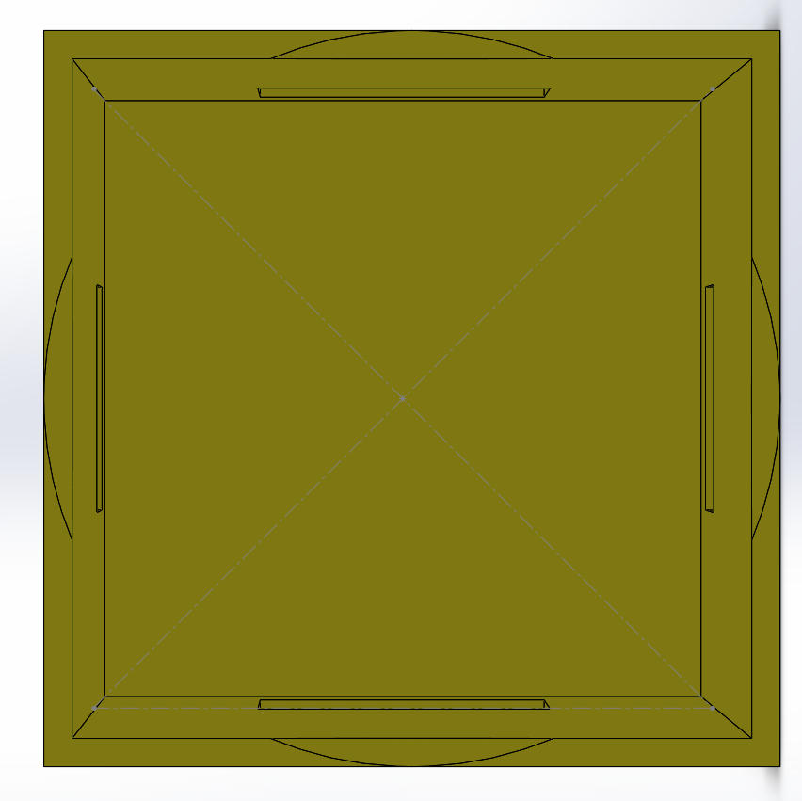
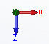
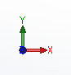
CAD design with major features was created
Complete
Requirement: CAD design shall include all the major features of the Drone
FRONT
View
Top View
5”
5”
9”
6”
55.15”
5”
Top View
Conclusion: The first major CAD design consisted of a 55.15” diameter envelope sitting around the a lift bag of the same size, It also included 4 motors with a 9” propeller at the end of a 6” Dshaft connected to a servo. Lastly it had a 5x5x5” gondola at the bottom in order to hold parts.

Slide 36
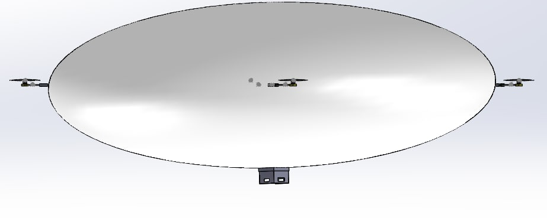
Enveloped Redesigned for Decreased Drag
Complete
Requirement: Envelope Shall minimize Drag while maintaining its 4m³ volume
20.133”
54”
54”
Front View
Conclusion: From the results of a drag analysis in Matlab it was found that a 108x108x40.3” Ellipsoidal envelope design was would reduce drag to a manageable 4.6N in a 20mph airspeed setting, while maintain our 4m³ required volume.

Slide 37
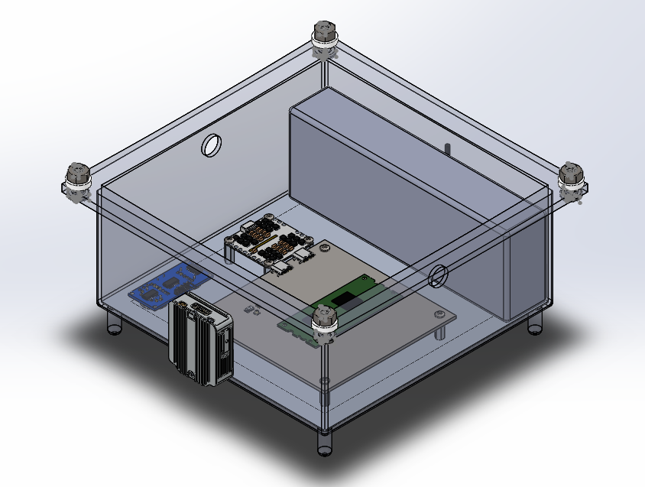
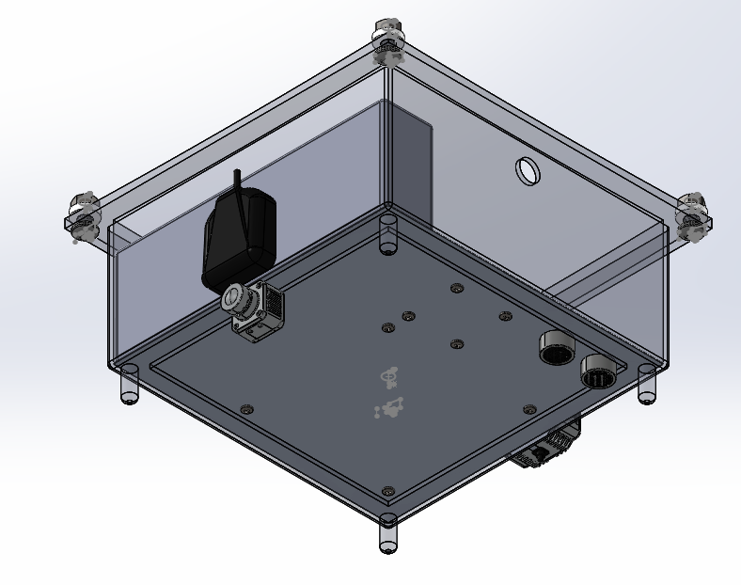
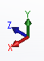
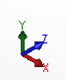
Gondola Redesigned to hold onboard electronics
Complete
Requirement: Gondola shall be able to contain all relevant electrical components
Landing Legs, were also added to Gondolas bottom to protect extruding sensors
Isometric view
Bottom, Right
Isometric view
Top, Right
0.75”
0.32”
7”
5”
7”
7”
7”
1”
Conclusion: Gondola interior will be 7x7x5” to holder necessary components, The largest of which where a 6.2” battery, and the estimated 4x4” PCB.
Notes:
Add demensions

Slide 38
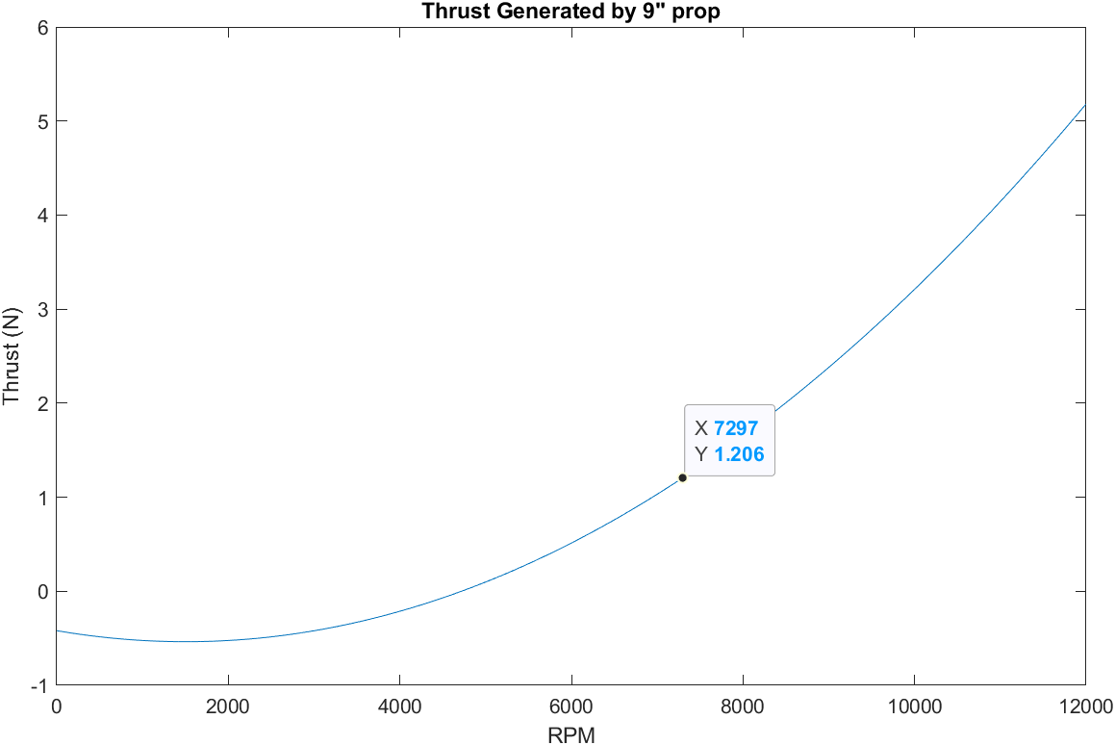
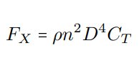
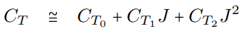
Required RPM for Propellers Forces was Calculated
Complete
Requirement: Propellers shall be able to Compensate for drag forces of 4.6N
Equations were taken from the Beard, Randal W., and Timothy W. McLain. Small unmanned aircraft: Theory and practice. Princeton university press, 2012
Coefficients of the propeller where estimated using a Propeller Analysis Program from aerodynamics4students.com suggested by Elkaim
⍴ = density, n=RPM, D=Diameter of Propeller,C_{T} is the Thrust Coefficient, J = Advanced Ratio
Force Equation for a propeller
Thrust Coefficient as cubic function
C_{T0-3} Were found using the polynomial regression, from the data given by the propeller analysis software provided by Elkaim
Conclusion : From Matlab Analysis of the Propeller equation, It was found that approximately 7300 RPM would be required to generate the required thrust of 1.2N; these equations were verified by an analysis by a lecture on propeller matching from http://web.mit.edu/
Notes:
Make into two slides

Slide 39
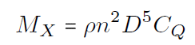
A Motor Was Chosen Using Data From RPM Analysis
Complete
A motor with a low Kv was chosen as lower K_{V} motors generally have higher torque ratings and can spin larger loads with less RPM loss
SK3 2822-1275K_{V} Brushless motor was chosen with a Max voltage of 12.6 V and a K_{V} of 1275 which would provided an RPM with no load of 16065 over double the estimated required RPM since a 9” propeller would be a large load.
With a K_{V} of 1275 this motor has a K_{T}(Torque Constant) of 0.00749 Nm/A.
The torque applied to the propeller was found using At 7300 RPM to be 77.43Nm
From the K_{T} Value and the propellor torque SK3 2822-1275KV should be able to get the Prop to 7300 RPM using only .6A well below its max of 8A
This was also verified by a third party test from Flybrushless that claimed that SK3 2822-1275kv could handle a 9” at a speed of greater than 7300RPM
Conclusion: SK3 2822-1275kv Brushless motor can produce more than the required thrust of 1.2N with 9” propellers
Requirement: Motor shall be able to spin propeller at required RPM
K_{V} to K_{T} Conversion and propeller torque calculations from Beard, Randal W., and Timothy W. McLain. Small unmanned aircraft: Theory and practice. Princeton university press, 2012
Notes:
Put into first slide

Slide 40
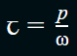
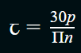
A Servo was Chosen Based on the Torque Applied to the Motor Shaft
Requirement: Servo must be able to Turn motor shaft with less then stall torque
Torque applied to the motor Arm was found using using ꞇ = lɑ
Moment of inertia was found from a Solidworks analysis and verified by hand to be 2.12kgm² x 10⁻⁴.
Ɑ, the angular acceleration was then found using ɑ= where or ɑ, can then be found, given the power and RPM of a given servo
RedCon 360 Degree Digital Metal Gear HV Servo has an RPM of 85 at a Power of 1.8W; this was then found to have an angular acceleration Ɑ of 687rad/s²
Using these numbers the estimated worst case Torque caused by the motor arm rotating about the y axis would be 0.143NM,
Conclusion: RedCon 360 Degree Digital Metal Gear HV Servo - DM 123 has a stall torque of 0.2NM which is greater than the worst case torque of 0.143NM required to turn the motor and shaft, while maintaining a light weight

Slide 41
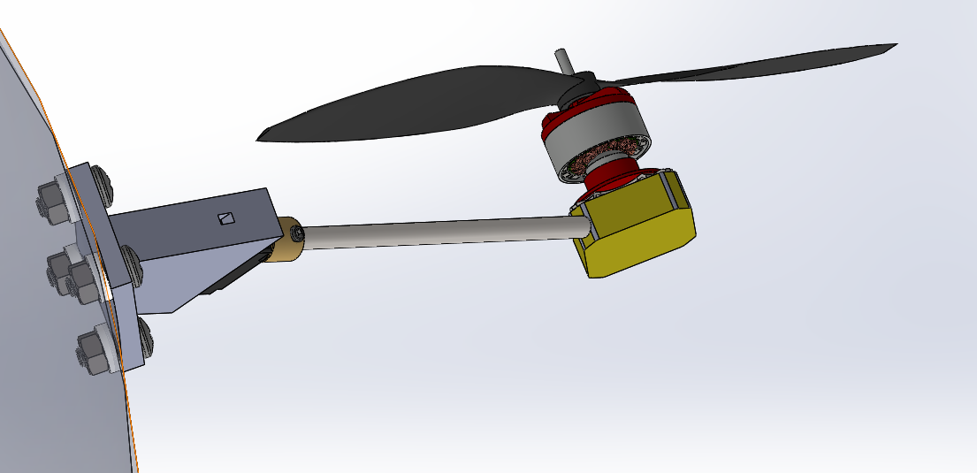
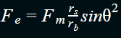
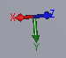
A Light Weight Material Able to Withstand Strongest Forces Applied to Envelope was Chosen
Complete
Requirement: Envelope material shall be able to withstand more than the forces applied by onboard parts
Of the Major Forces acting on the Envelope the Force applied from the Motor arm arm will be the largest
Using equations from Physics for Scientists and Engineers, 4th edition, by Douglas Giancoli. This force can be found with
A Force of 71N would be applied in a worst case scenario where theta is 1 and the motor force is 5N(double its expected largest value). This would be applied over half the area of the mounting bracket or 2.4in²
Conclusion: 1.0 oz HyperD XL has a tensile strength of 44psi which is greater than the worst case of 6.63psi while maintaining a weight meeting our required system weight and maintaining a low price point.
Isometric view from
bottom, left
r_{b}
r_{s}
Force Diagram showing values used in equation
F_{e} is the force applied to the envelope
F_{m} is the force applied from the motors movement
r_{s} and r_{b} are the radius of the bracket and shaft
θ
F_{e}
F_{m}
θ

Slide 42
3D Printing Material was Decided On
Complete
Requirement: 3D printing materials shall be able to support forces applied by drone parts (Largest 6.6psi)
3D printing materials pugh chart
Conclusion: All of these materials are sufficiently strong, however Nylon was selected due to its higher print accuracy and outside applications.

Slide 43
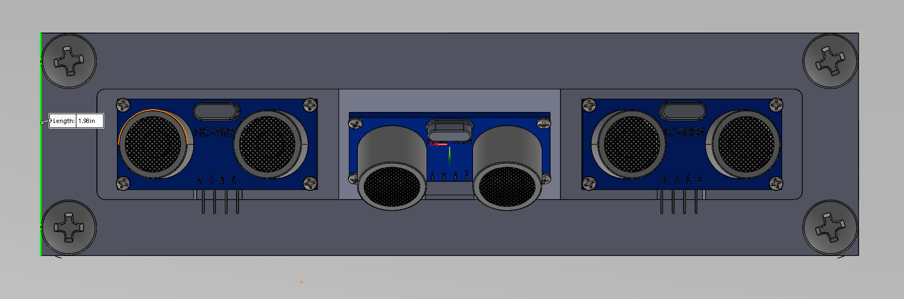
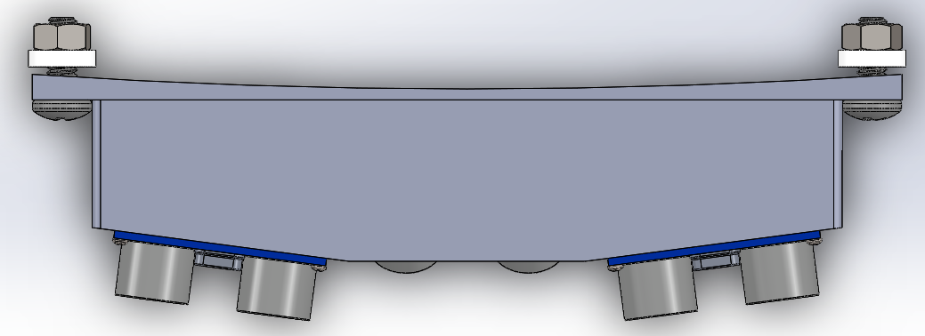
A Mount for Forward Facing Ultrasonic Sensors was Created to Increase Viewing Angle
Complete
Requirement: The sensors shall be able to monitor area in front of the drone in order to maintain constant height of 1 m.
The Center Ultrasonic sensor was tilted down at 45°, in order to obtain the height of upcoming obstacles.
7.3”
2”
Front View
Each ultrasonic has a range of 15° so by angling the outside sensors to be 7.5° away from the center, this increases the viewing range of the ultrasonics to 30°.
Top View
7.5°
15°
Conclusion: this bracket will allow us to mount 3 ultrasonics to the front of the drone in order to tell height and collision distance, with a wider detection range of 30°.

Slide 44
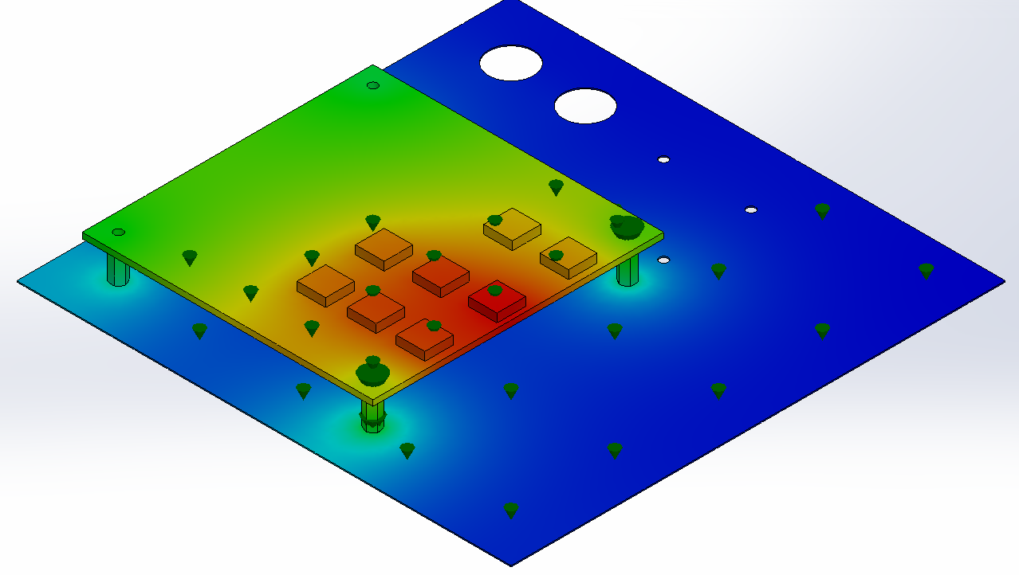
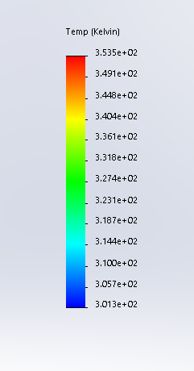
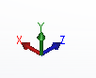
Heat Analysis done on Voltage Regulators
Complete
Requirement: Heat sink shall be required if worst case steady state temperature is greater than voltage regulator max operating temperature (125°C )
Isometric
Top, Right
A Thermal Analysis of the PCB with voltage regulators, gondola, and envelope was done in Solidworks.
(Gondola and envelope not included in image so PCB is visible)
4”
4”
PCB
Aluminum plate
¼”
7”
7”
Conclusion: since the worst case steady state Temperature 80°C is within the operating range of the voltage regulators (40-125°C ), A heat sink is not needed, more analysis may need to be done, as heat loss for other electronics is found.

Slide 45
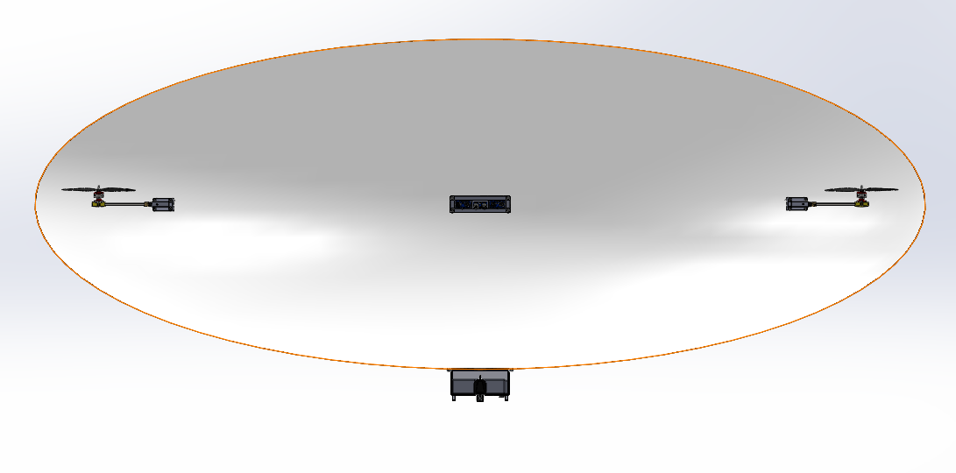
CAD Design was Updated with All Parts to be Fabricatable
Delayed: Expected 3/21
Requirement: CAD design shall be fabricatable, and shall have a total mass with payload of <4.5kg
Full CAD Assembly of the Drone with all parts ready for fabrication
40.1”
9”
108.1”
6”
5”
7”
Front View
Conclusion: With many iterative updates applied such as adding screws, nut, washer, and standoff attachments, the total system weight with payload is estimated to be 4.03kg. The CAD design is ready to be fabricated, as soon as the RC controller is finalized, so the receiver can be added to the CAD

Slide 46
Suppliers for Materials are Being Finalized
Late: Expected 3/25
Requirement: All parts shall have a supplier that they can be obtained from
Struggling to find a helium supplier.
I have asked BELs and they say they do not know of any lab that uses helium.
There are certain party stores that sell it but this is quite expensive
Jonathan Glen (our client) thinks that there are on campus labs that will allow me to use their helium/ buy helium through them. Do you know of any?
Conclusion: The vast majority of of our parts have the supplier finalized and can be ordered, Helium supplier has not been finalized as most retailer party stores are very expensive and I am still searching for a better supplier such as through the school.

Slide 47
Overview of Controls Progress
Progress in meeting the Path following and terrain tracking milestone was made and broken down into the following slides Late Due Date: 3/19 - Expected 3/21
Small Angle Approximation Successfully Applied to the Rotation Matrix Complete
Symbolic Solution of Linearized Plant Definition Complete
Path Following and Terrain Tracking Late Due Date: 3/19 - Expected 3/21
Previous Progress in the RC System Response Complete
Remote Control Servo Angle Calculation Complete
Remote Control Throttle Adjustment Complete
Upcoming Milestones
Path Following and Terrain Tracking Design - Noisy Sensors: Due 4/12
Closed Loop Remote Control Design: Due 4/12
Conclusion: We are approximately two days behind schedule for the autonomous control development, but have finished State State Definition of the System as well as Open Loop RC Response

Slide 48
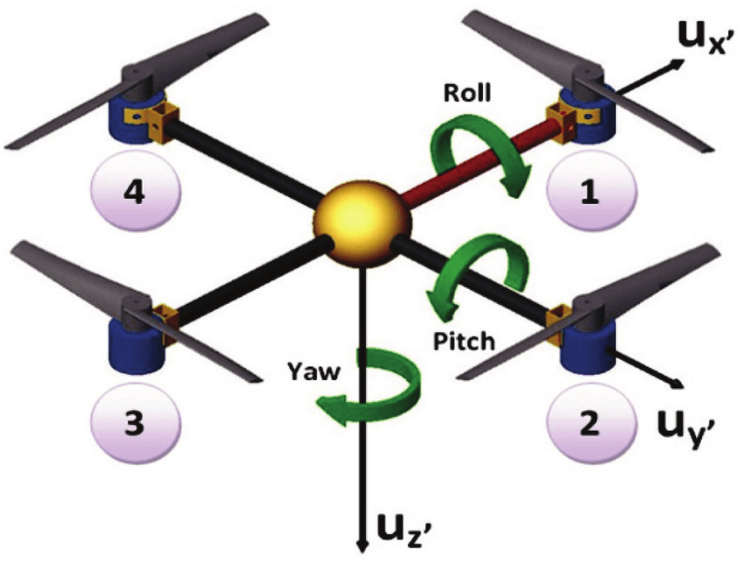
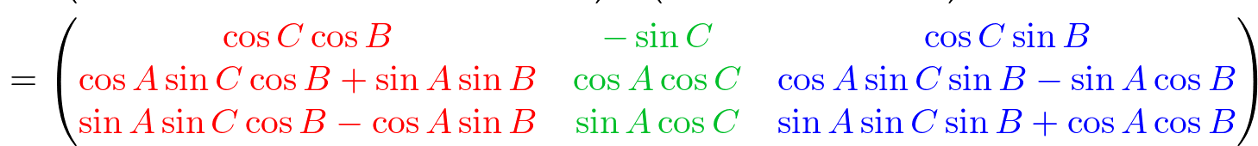
The Standard Drone Rotation Matrix Needs Simplification
Complete
The Rotation Matrix, used to calculate the drone’s attitude, is highly nonlinear and is difficult to work with in control systems.
The Figure to the right shows the standard drone setup and angles, and its rotation matrix is provided below.
However, we are designing a buoyant drone and tilt our motors instead of our entire drone body, so we can simplify the matrix on the next slide
Fig. Normal Rotation Matrix for Pitch, Yaw, and Roll
Ahn, Song Ho. OpenGL Angles to Axes, www.songho.ca/opengl/gl_anglestoaxes.html.
Fig. Pitch Yaw and Roll Angles of a Standard Quadcopter
Quad Band Signal Strength Monitoring System Using Quadcopter and Quad Phone - Scientific Figure on ResearchGate. Available from: https://www.researchgate.net/figure/Yaw-pitch-and-roll-rotations-of-a-Quadcopter_fig1_280573614 [accessed 19 Mar, 2021]

Slide 49
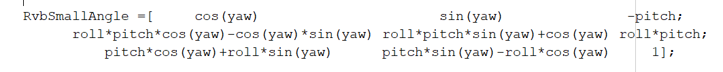
Small Angle Approximation Successfully Applied to the Rotation Matrix
Complete
Since we do not tilt our drone to move, the pitch and roll angles are near zero and the small angle approximation applies.
The Sin of an angle is just the angle, and the Cos of an angle is 1.
We cannot apply this approximation to the yaw angle, which serves as our heading angle, since we need to be able to turn 360 degrees.
From here we can treat sin(yaw) and cos(yaw) as constants that we continually update.
Conclusion: The Small Angle Rotation Matrix is accurate for normal operation and will be applied in linearizing the control system. Simplified matrix provided below.
Figure. Rotation Matrix with Small Angle Approximation

Slide 50
Symbolic Solution of Linearized Plant Definition Designed for Autonomous Controls
Complete
Requirement: The Plant needed to be defined in state space form for full state feedback design. This process is broken down into the following slides.
Creating a nonlinear system is extremely complex and also increases our response update times, so we linearized it by taking partial derivatives of the equations
Choosing operating points to linearize equations around
Created a Matlab script to linearize the force equations and form the A and B matrices for the Plant Definition when given the accelerations, states, and inputs,
This will help us update the plant faster with any adjustments
Conclusion: By applying these changes to the system, we were able to linearize the Plant definition, to define the Pitch, Yaw, Roll, and Positions, as well as their respective forces

Slide 51
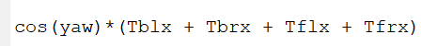
Partial Derivatives Taken of the Acceleration Equations to Aid Linearization
Complete
To gain a linear model, we need to solve for the linear slopes of the equations at separate points, so we take partial derivatives of the acceleration equations to get a linear combination.
For example, this is a portion of the equation used to calculate the north acceleration, by taking the partial derivative with respect to Tblx (a throttle value), we can estimate its linear contribution to north acceleration.
Conclusion: This model is only accurate around the point the slope is tested, known as the operating point, so we need to define those points in the next slide.

Slide 52
System Operating Points Defined for Plant Definition
Complete
Requirement: We needed to define the operating points of the drone to linearize around the plant to begin developing the control system
Up Thrust | Pitch and Derivative | Roll and Derivative | East/North Velocities | Down Velocity | Yaw
0.25 Newtons | 0 | 0 | 6.3 m/s | 0 | Cont. Updated
Table. Operating points used in system linearization
Conclusion: Using these operating points we can build the linearized state space system.

Slide 53
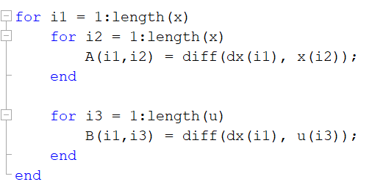
MATLAB Script Developed to Linearize System Automatically
Complete
A MATLAB Script is needed to help update the State Space Matrices so we can make system updates as needed.
We used a for loop in matlab to go through the states and inputs to take the partial derivatives of the acceleration equations
Since we used a for loop, we know where the resultant values are in the A and B matrices for the plant, so we linearize the system and find our matrices at the same time.
Excerpt of StateDefinition.m, used to find linearized A and B Matrices

Slide 54
Path Following and Terrain Tracking Simulation is Behind Schedule
Late: Due 3/19
Expected: 3/21
Requirement: Simulation of the PID Controller in MATLAB should be capable of following a path and maintaining height.
For this task to be complete:
The PID Controller must be designed in MATLAB
The controller must be discretized to simulate microcontroller operation
The input commands must be outputted to a nonlinear model in order to simulate a more realistic response
The drone must be able to follow a path and maintain its height in a MATLAB simulation without intervention
Currently behind due to the decision to make a MATLAB script to aid Matrix Designs, and I have encountered a problem with the pole placement function in MATLAB, so I am trying to identify the problem there.

Slide 55

Complete
Remote Control Servo Angle Calculation
Requirement: Take in RC commands and translate them into servo angles in order to control the drone in flight.
We should be able to turn, go forward/backwards, go up/down, and combinations of the three.
Conclusions: The equation was designed for use of turn and forward values between -1 and 1, and will never provide an output above pi/2. Additionally, it allows forward, turning, and upwards control. The angle calculation does not consider a moment created by different angle values, so a throttle adjustment needed to be developed.

Slide 56

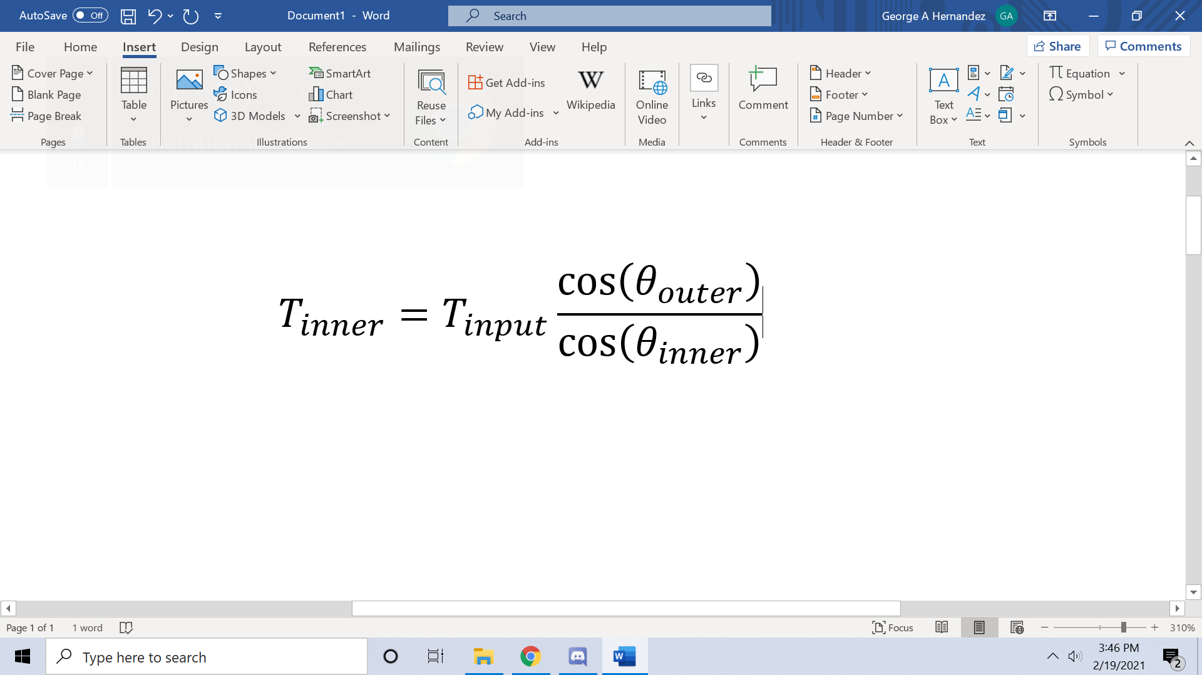
Complete
RC Throttle Adjusted to Remove an Unintentional Moment
Requirement: We need to eliminate the unintentional moment created by the angle calculation function
Only solving for the angles of the servos, an unintentional moment can be created, so we needed to equalize vertical forces
Needed to isolate vertical force component on the far turn side, and use that as max for near turn side
Conclusion: Change was Implemented and prevented that specific unintentional moment, but this is still an open loop control system and we need better stability
Fig. Unintended moment caused by previous RC iteration. V1
This situation is caused by going forward and turning at the same time, causing the motor angle to point downwards at commanded throttle

Slide 57
Overview of Drone Flight Simulation
Progress in drone flight simulation were made and broken down into slides covering:
Implement Simulation Environment - Complete
Apply Forces to the Drone Due 3/12/21 - Late, Expected 3/23/21
Buoyant Force Complete
Propeller Force Complete
Drag Force Late - Expected 3/23
Implement Remote Control Design Complete
Conclusion: Drag Forces delayed to March 24th, due to RC implementation needing to be done first.

Slide 58
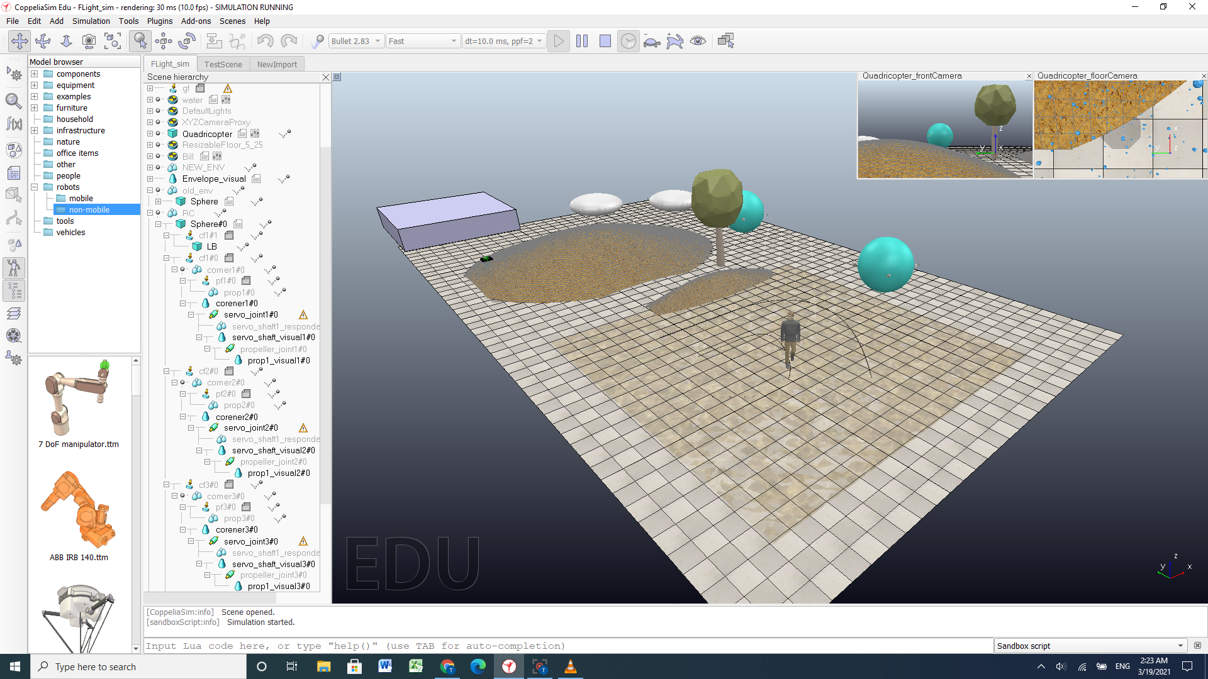
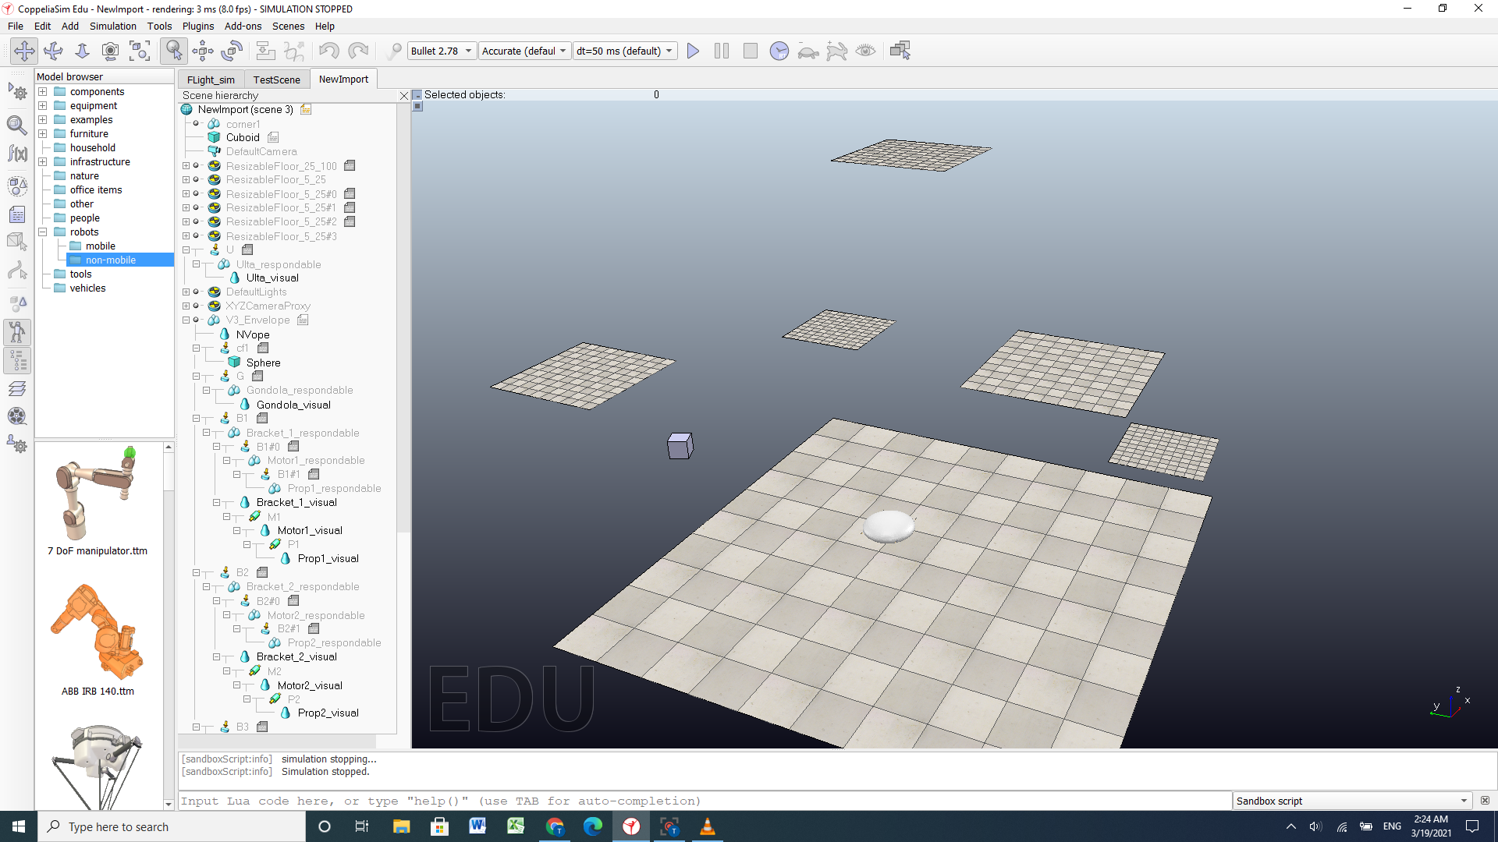
Drone Simulation Environment Created to Test a Fully Functional Flight
Complete Review
Requirement: Create an environment, in which the drone’s flight controls can be fully tested in variable flight conditions.
Simulation environment intended for use as crash course and for obstacle avoidance.
This environment is intended for vertical flight testing and eventually wind stress testing.
Conclusion: Environments are fully functioning and awaiting a completed functional drone for flight testing.

Slide 59

Apply a Buoyancy Force in VREP
Complete Review
Requirement: Buoyancy force should be applied as a constant, continuous force and simulate as close to the real balloon as can be handled.
A continuous buoyancy force is shown.
Conclusion: The buoyancy force works as a continuous force upward using a lift bag to promote a center of buoyancy moment directly above the center of gravity; thus, creating greater stability and decreasing the effective weight.
Notes:
Used lift bag since buoyancy force no longer has a slider Justification: Lift bag added since adding a world relative upward force applies that force specifically to the center of the shape

Slide 60



Individual Propeller Forces and Servo Movement in All Directions Are Implemented
CompleteNew
Requirement: The drone moves completely controlled by propeller forces.
Turning servo motor upward moves the balloon in an upward direction.
Servo turned down using ‘Descend’ feature.
Servo turned left.
Servo turned right.
Conclusion: Propeller Forces apply torque to the balloon, a new factor needed to be considered in order to center the balloon’s mass. Forces can be seen to be applied in a radial direction outward from the shaft of the servo.

Slide 61

Remote Controlled Forward/Backward Motion is Implemented
Complete
Requirement: The drone is provided a new axis for full remote control , the pitch angle controls.
Propeller force implementation allows the propellers’ speeds to control the drone’s speed and the servo rotations to control each propeller’s direction, thus changing the direction of the drone.
Conclusion: An issue we found in the design is that the balloon will move faster than the moment of mass, causing an initial unbalance between gondola and balloon. The ballon corrects itself as the acceleration reaches a constant and gondola catches up to the moment of mass.

Slide 62
Turning in Remote Control Implemented Along with Back and Forth Movement
Complete
Requirement: The drone is provided a new axis for full remote control , the yaw angle controls.
Back and forth motion means all propellers rotating as one movement, and ‘turning’ rotates opposite pairs of servos in mirrored motion across the z-axis. Descent causes a 180 degree rotation to each control feature.
This video shows counterclockwise and clockwise rotation to the balloon given a certain amount of turn required, which changes the degrees the motor turns the servos.
Conclusion: Due to the position of the center of mass relative to motor positions, the pitch and roll angles destabilize, so we need to develop a closed loop remote control response.
Notes:
When turning exceeds a certain degree, 81 degrees, gravity exceeds the upward propeller force and the drone descends To account for those unbalances

Slide 63
Descent Functionality Implemented for Turning and Horizontal Movement
Complete
Requirement: The drone’s full remote controls extend into descending flight.
This video showcases descent functionality, which lets the balloon’s movement be controlled as it is descending, but will be used less often since the average hovering height rises to around 1m.
Conclusion: Descent functionality moves with relative ease due to gravity moving in the same direction as the propeller forces.

Slide 64
End

